Slide 1
Remembrance Day

Slide 2
What does remembrance mean?
Remembrance is remembering or recalling something or someone.
Remembrance is doing something special to share the memory and remind others.

Slide 3
Who are we remembering?
We those who have died during wars, acting on behalf of our country in all the conflicts since the First World War.

Slide 4
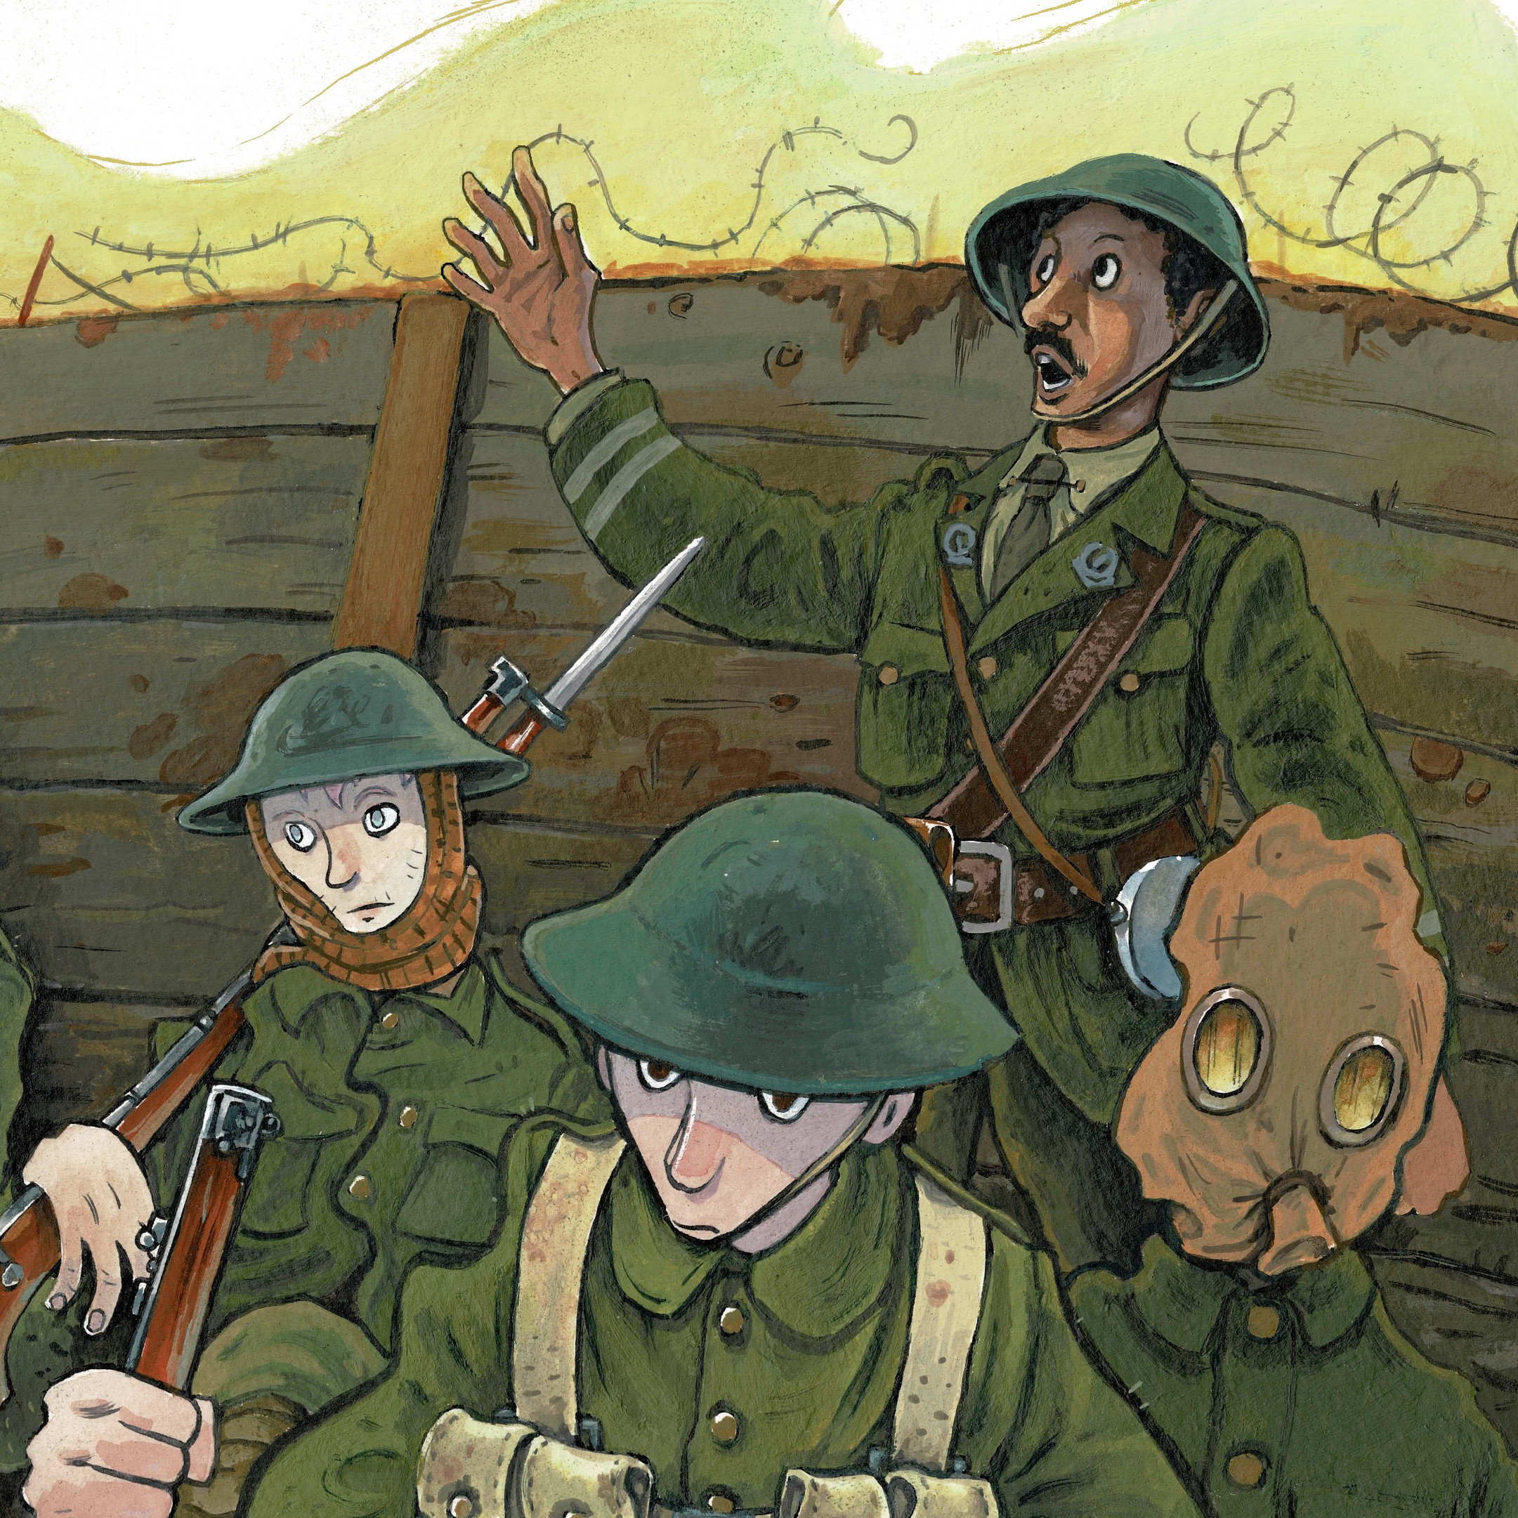
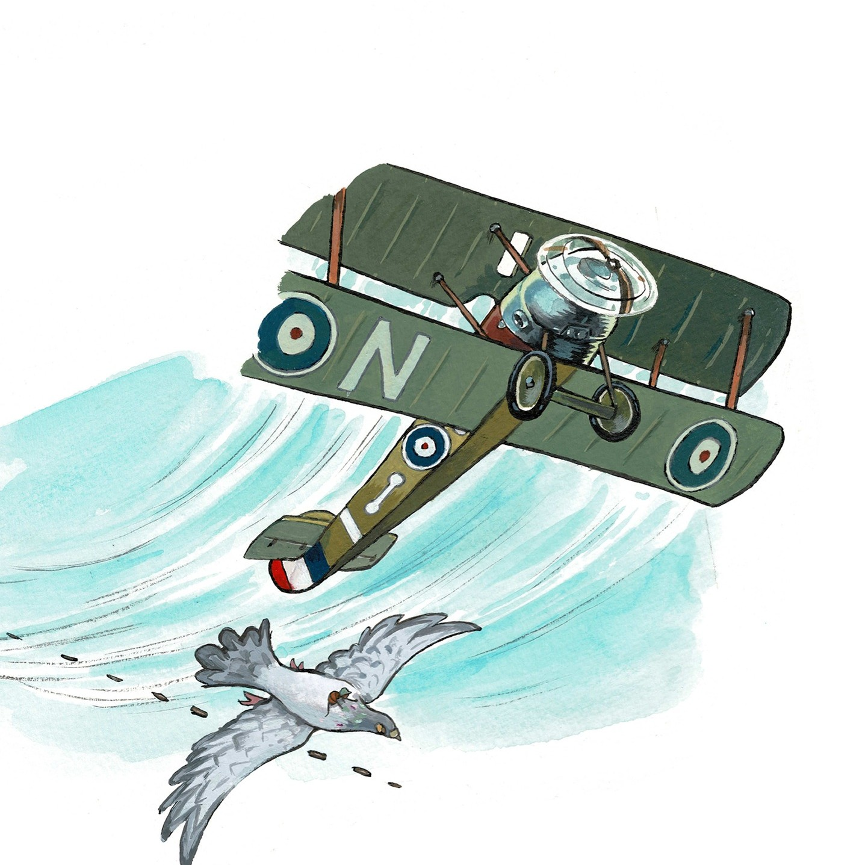
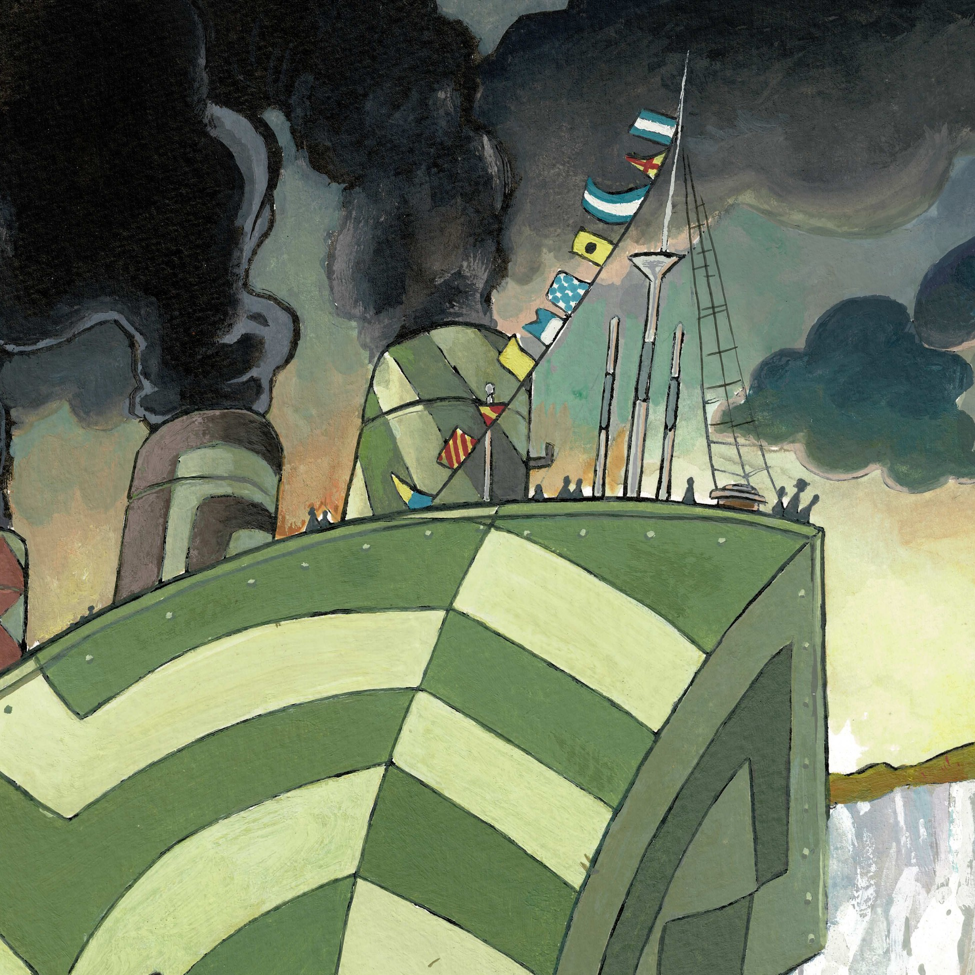
Who are we remembering?
This includes people from the Army, Navy and Air Force.

Slide 5
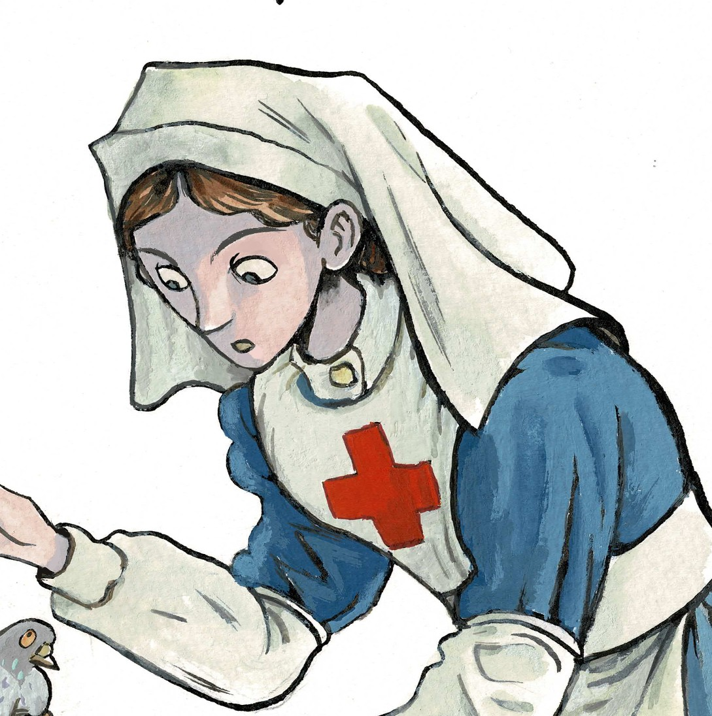
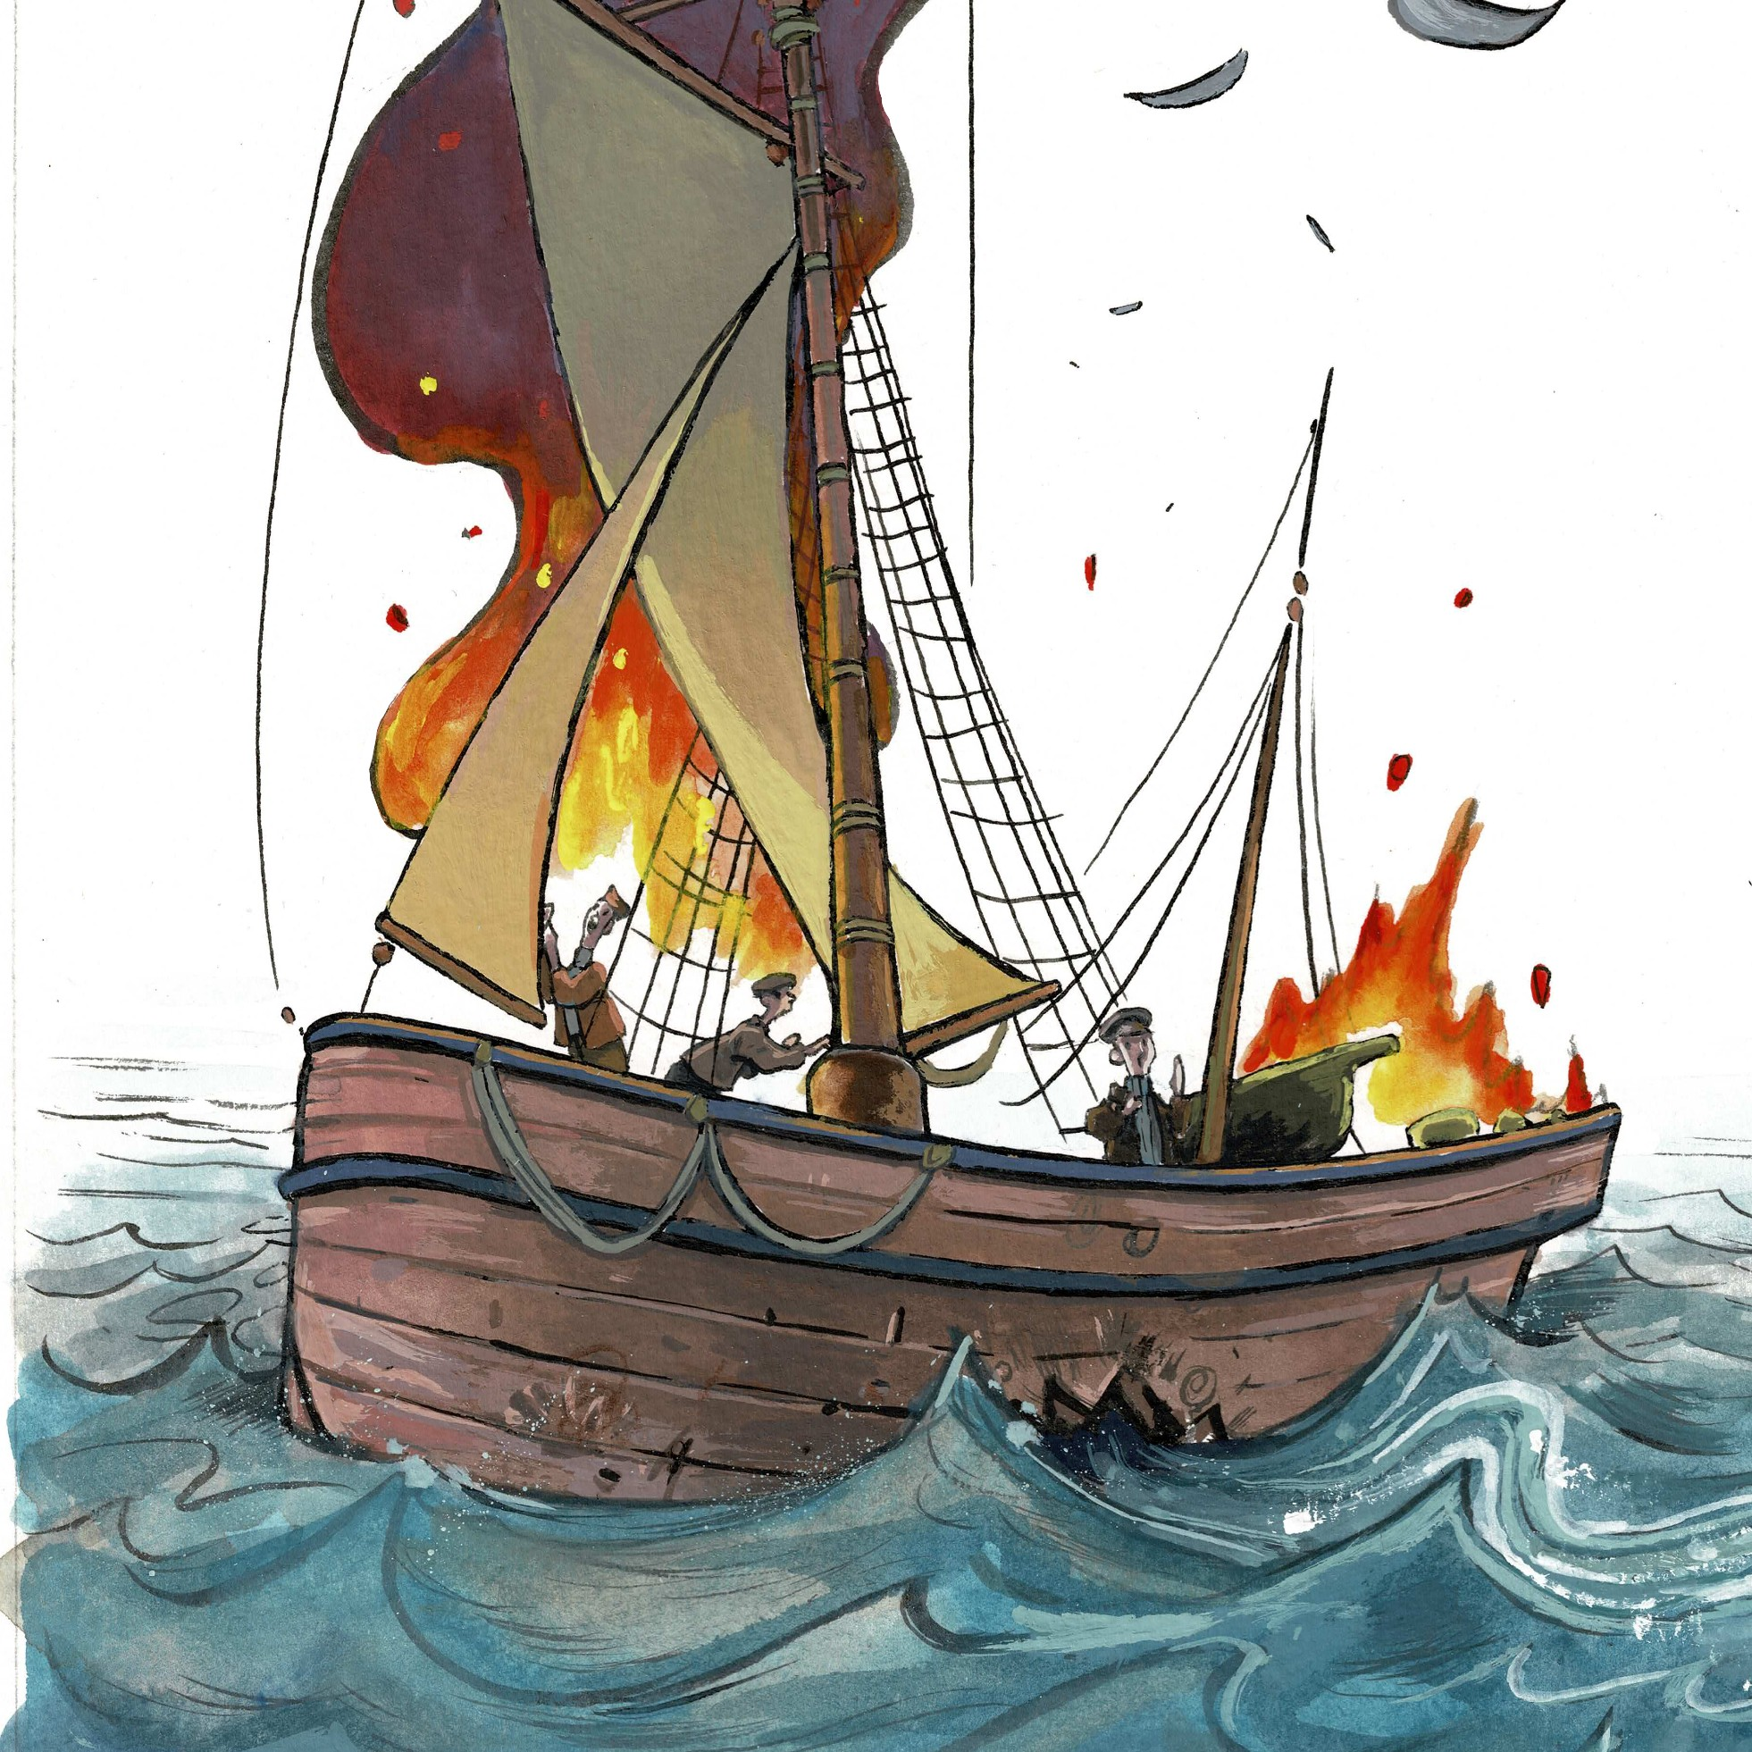
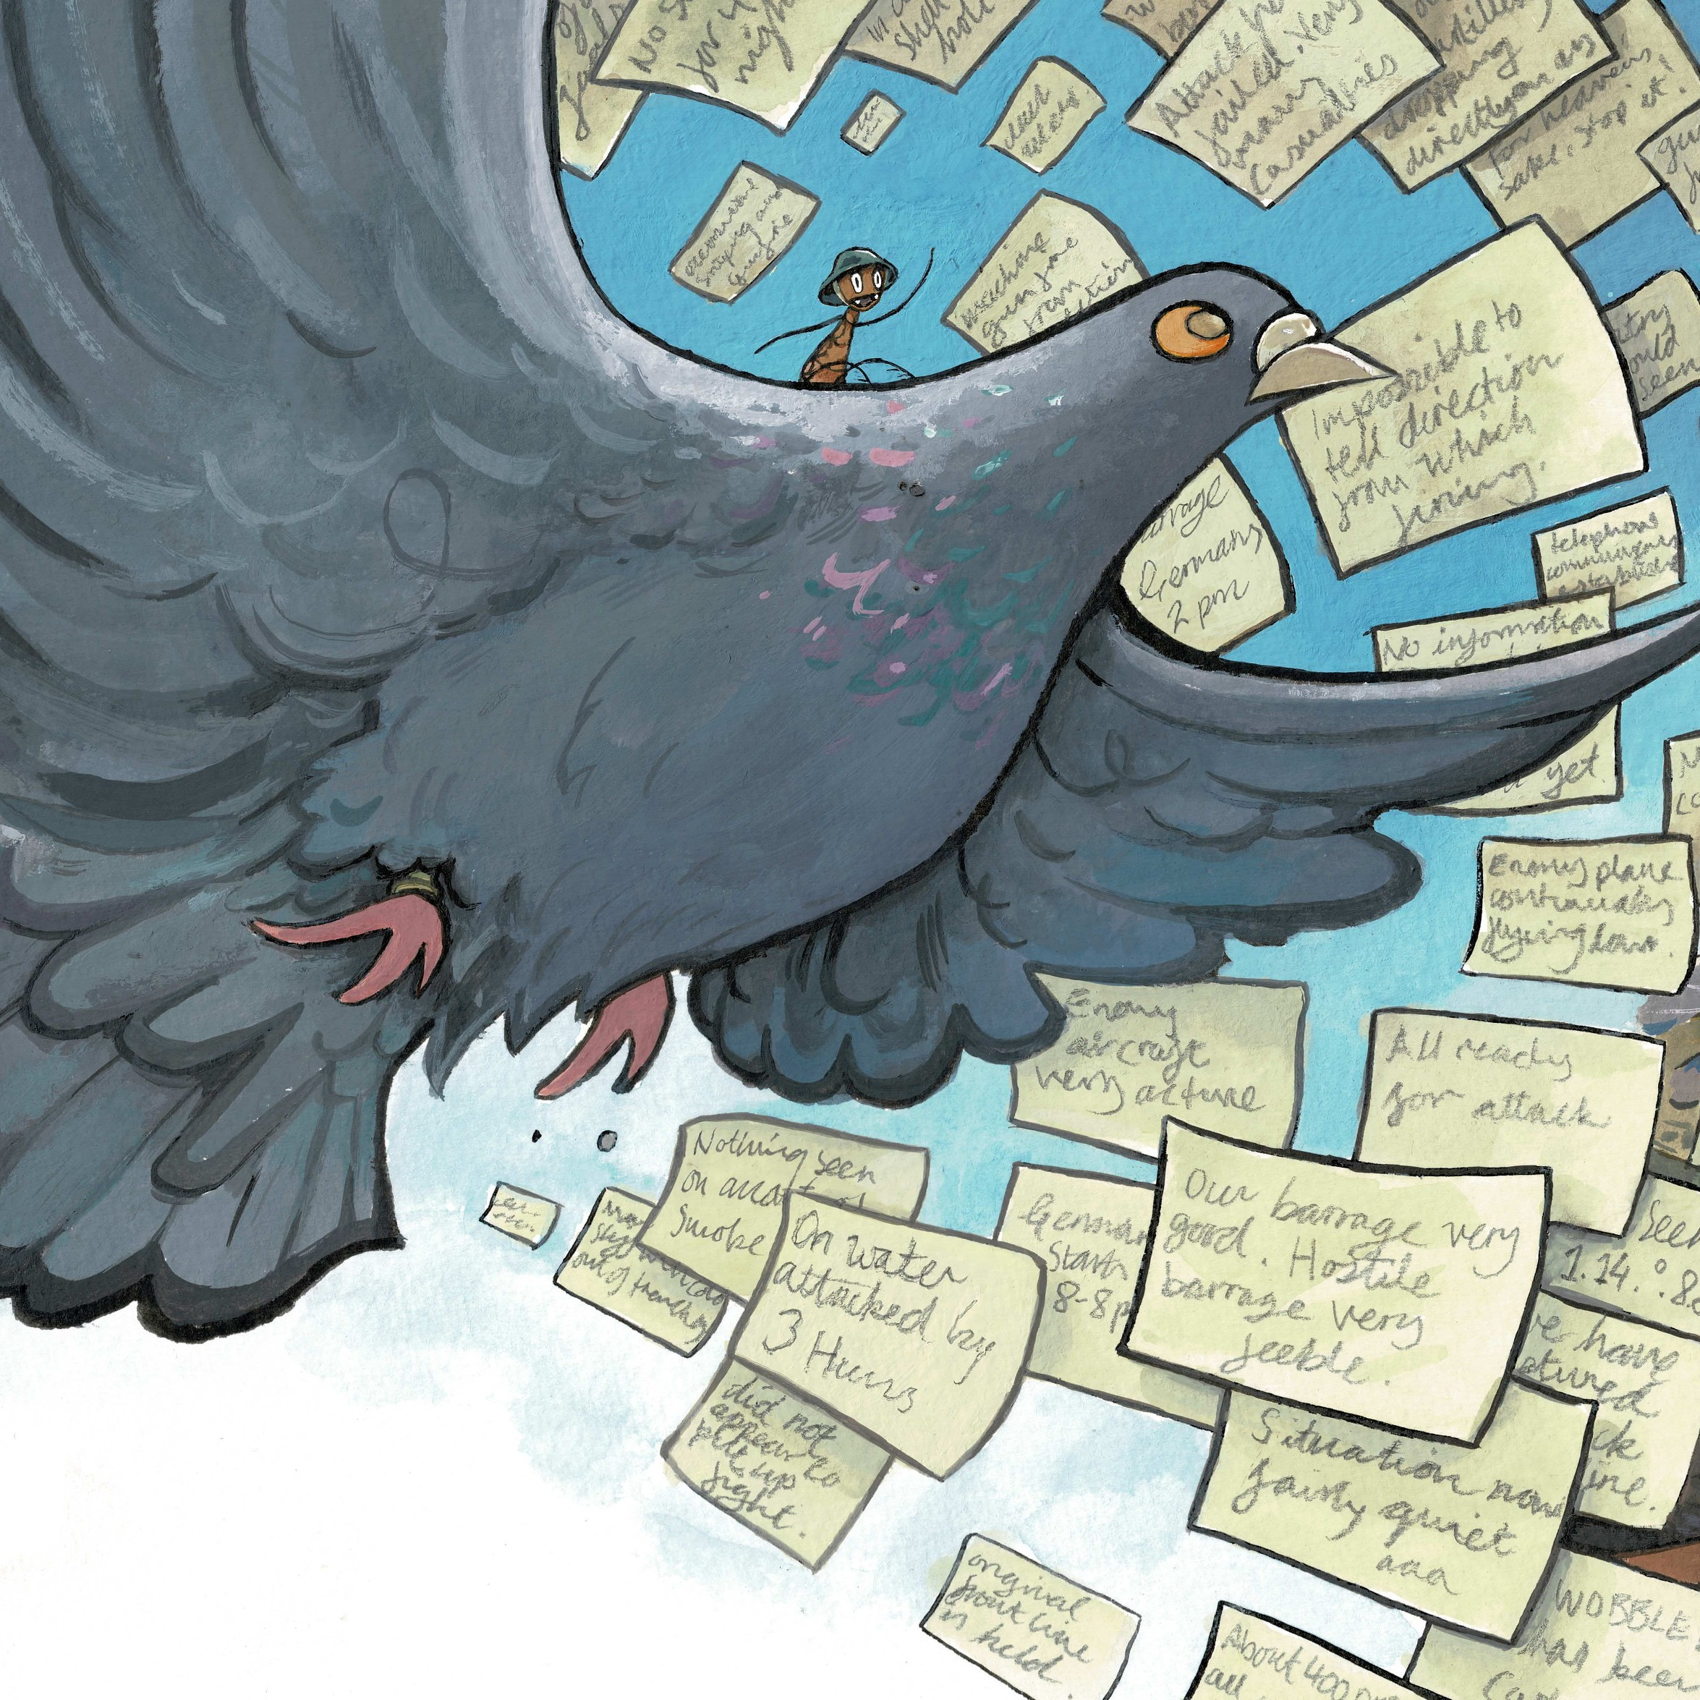
Who are we remembering?
Also many others such as fishermen, medics and animals that carried messages.

Slide 6
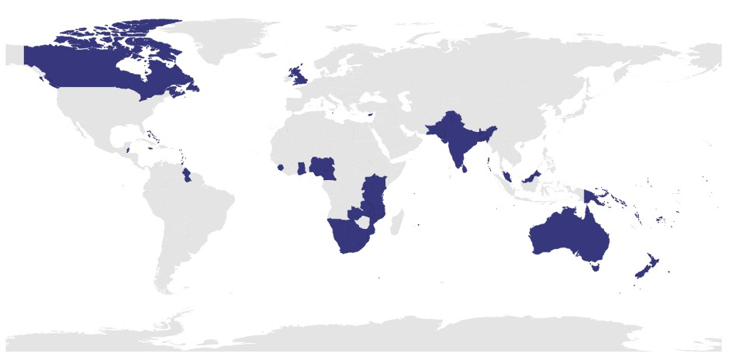
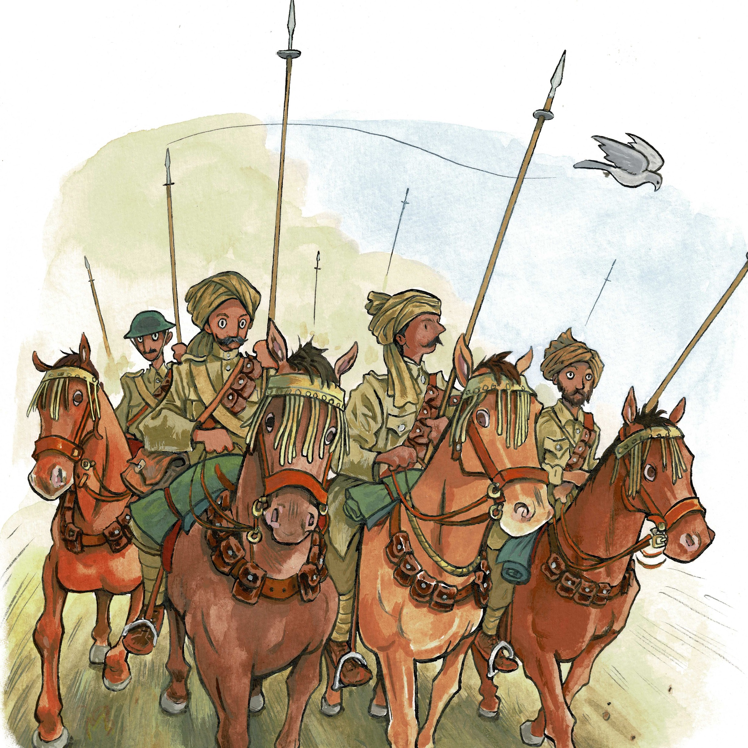
Who are we remembering?
They came from the UK or from Commonwealth countries around the world.

Slide 7
Why do we have Remembrance Day?
We have Remembrance Day to show respect and thank those who faced danger.

Slide 8
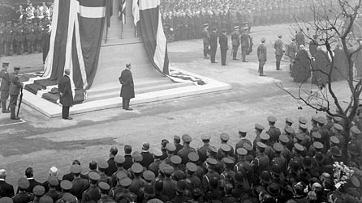
After World War One many people had relatives and friends that they loved who had died and been injured.
Communities wanted a way to commemorate them. In 1919 a monument was built and a day was set to remember.
The monument is called the Cenotaph.

Slide 9
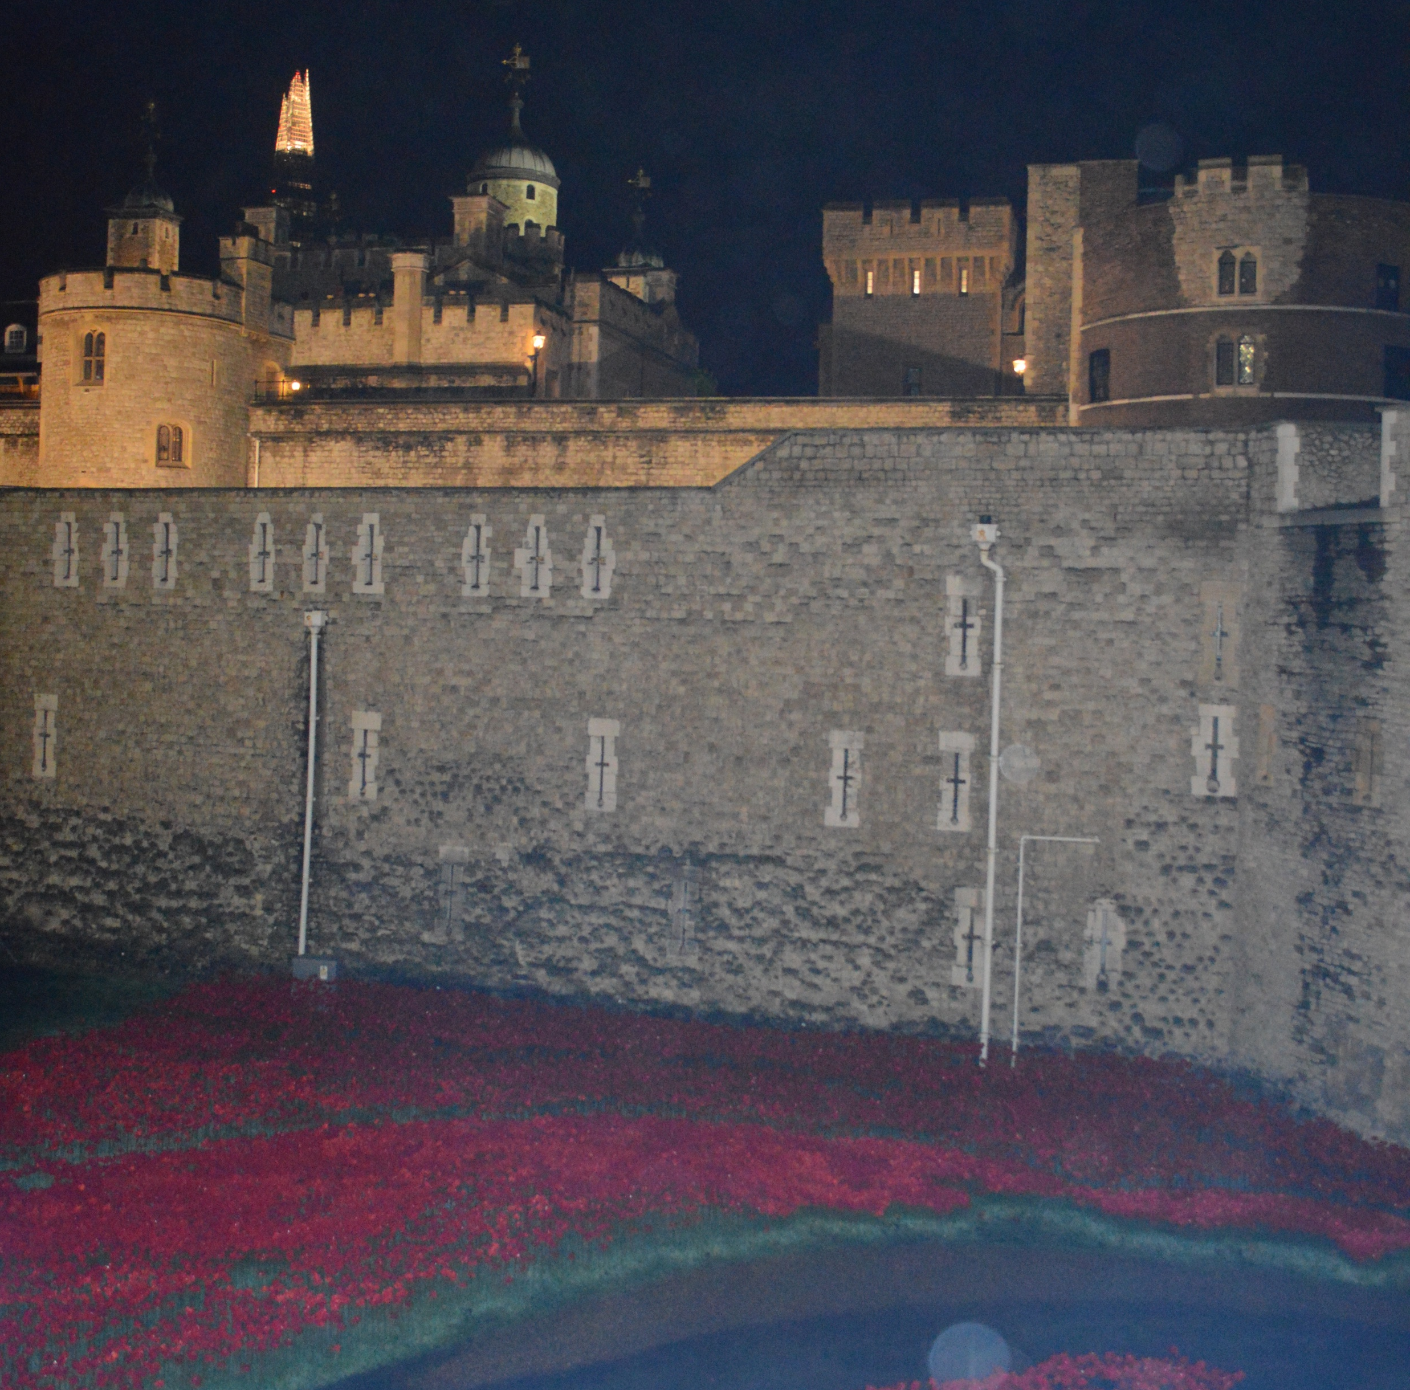
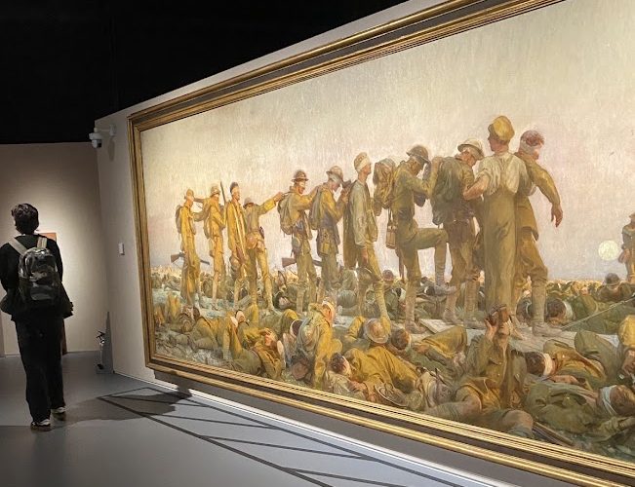
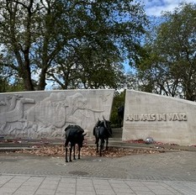
Other memorials
There are many other memorials and art that has been made to remember.
Poppies at the Tower of London
Art at the IWM
Animal memorial

Slide 10
When is Remembrance Day?
The First World War ended at the eleventh hour, on the eleventh day of the eleventh month.
11 o’clock on 11th November
Events happen on Remembrance Sunday which is the nearest Sunday to 11th November.

Slide 11
How do we show that we remember?
A poet called John McCrae fought in the First World War and he wrote:
“In Flanders Fields the poppies blow…”
After the war poppies grew on the battlefields and they became a symbol of the sacrifices.

Slide 12
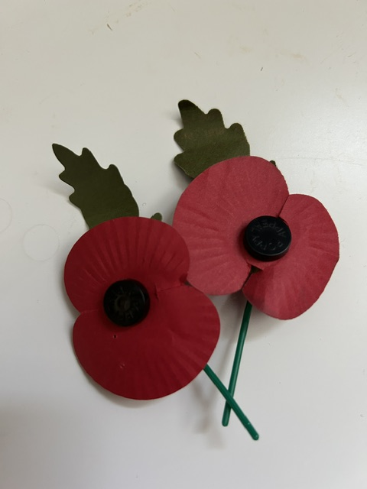
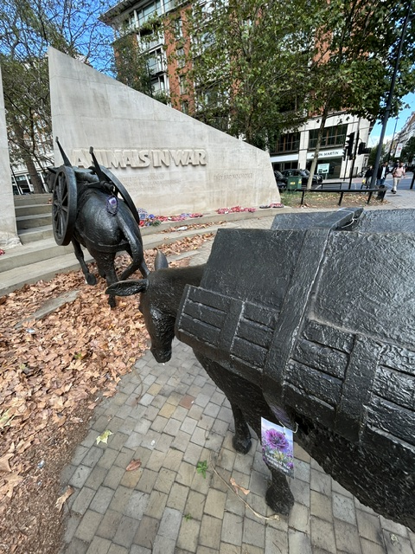
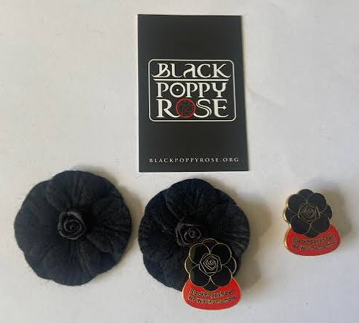
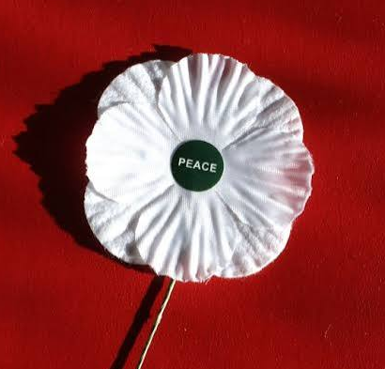
There are different poppies to remember various groups
To remember and support people who served in wars
To remember and support animals affected by wars
To remember and educate about the contribution of black, African and Caribbean communities
To remember but also focus on peace for the future

Slide 13
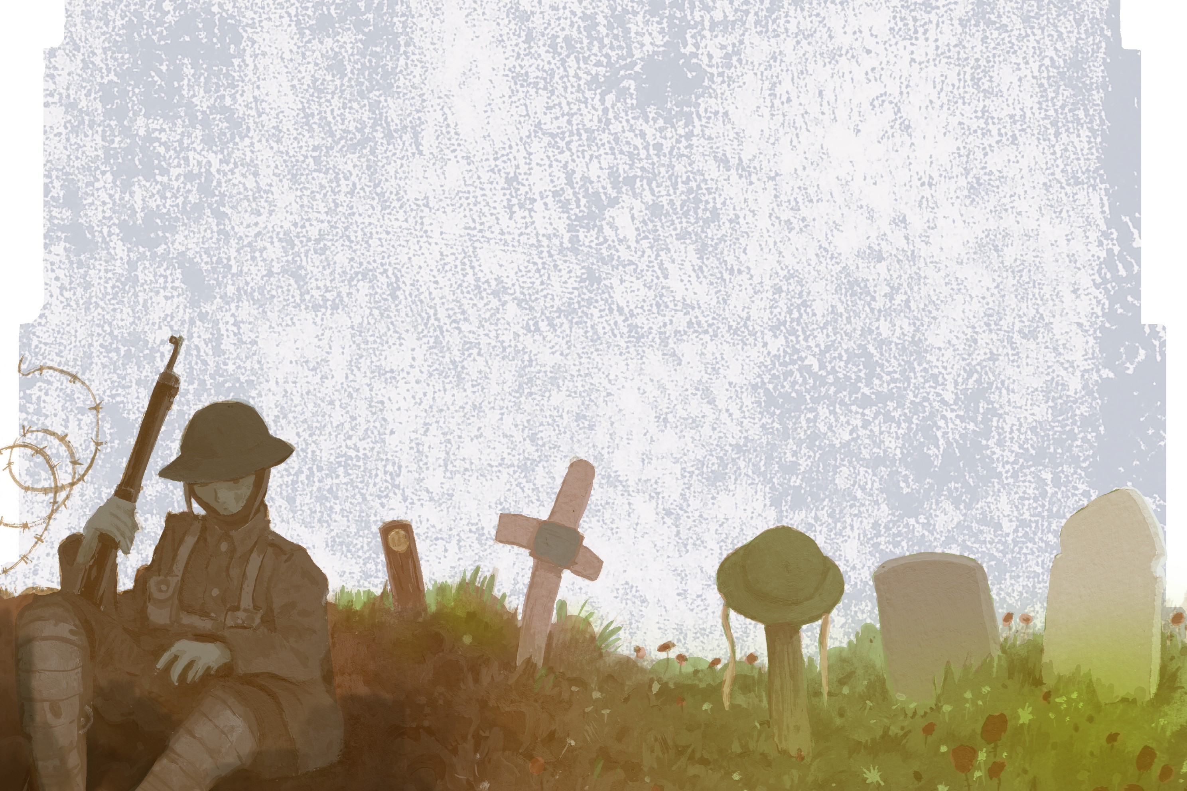
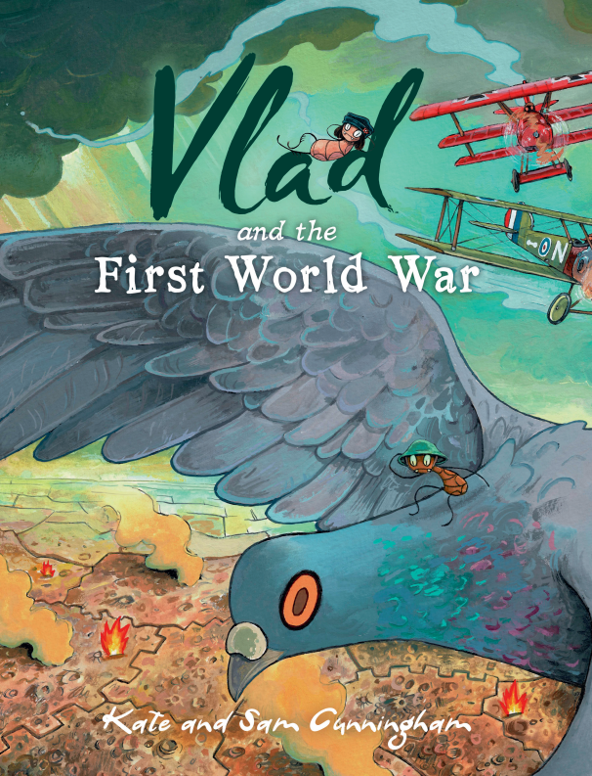
All illustrations in this PowerPoint have been taken from Vlad and the First World War
This PowerPoint is free to use and share but images are © Sam Cunningham.

