Slide 1
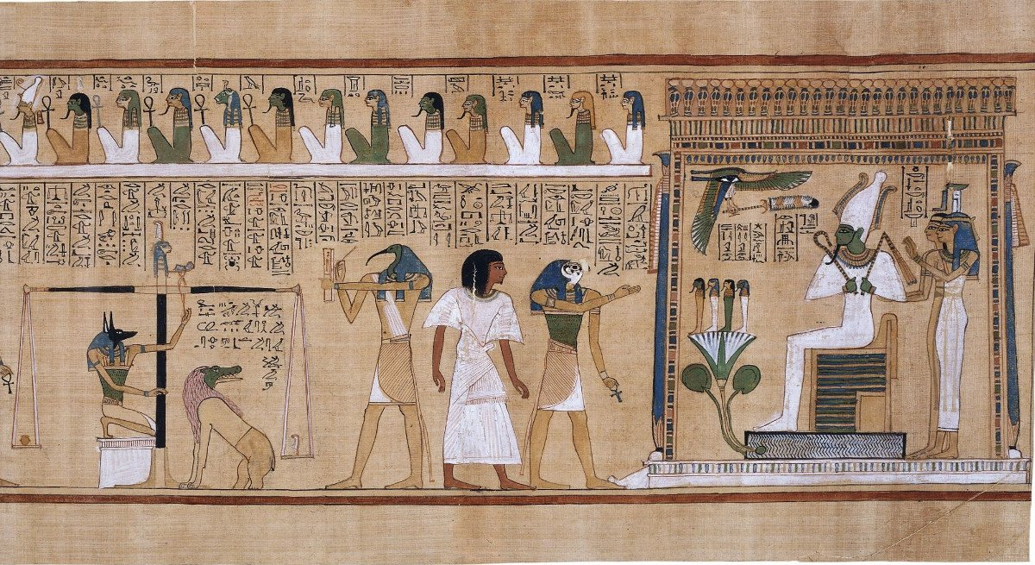
The gods of ancient Egypt
All the gods described on the slides are in the picture. Look at the image, read the clues, then use them to identify which god is being described – it won’t be immediately obvious, so think carefully.
Once you have chosen a figure note which animal or colour they are associated with.

Slide 2
Which figure is Osiris?
I was the first child of Nut.
I became the second ruler until I was killed by my brother.
My sister put me back together and brought me back to life, but now I am god of the underworld and I carry the pharaoh’s crook and flail to show my power.
I greet the dead into the Field of Reeds if they pass the test.

Slide 3
I am Osiris
I am shown with green skin.

Slide 4
Which figure is Isis?

Slide 5
I am Isis

Slide 6
Which figure is Anubis?
I am the god of embalming.
I weigh the heart against Maat’s feather to judge if the dead has had a good life and travel onto the Field of Reeds or if they will be devoured if their heart is too heavy.
My statue often protects the dead in their tombs.

Slide 7
I am Anubis
I have the head of a jackal.

Slide 8
Which figure is Thoth?
I am the god of learning, wisdom and writing.
I write down the results of the judgement when they come to the underworld.
I tricked the moon into giving us five extra days so Osiris could be born and so ancient Egyptians measured the year in 12 months of 30 days with 5 extra days at the end of year.

Slide 9
I am Thoth
I have the head of an ibis.

Slide 10
Which figure is Horus?
My mother kept me hidden from my uncle until I was an adult because he killed my father.
When I had grown I challenged my uncle, we fought and I won, but I lost my eye. Once it was returned to me it became a symbol for healing.
I protect and accompany the pharaoh during life and their journey and guide them to Osiris.

Slide 11
I am Horus
I have the head of a falcon.

Slide 12
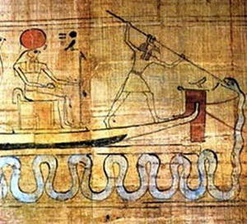
Which figure is Set?
I am god of chaos.
I killed my brother to become ruler, but was eventually defeated by his son.
After that I was given the job of accompanying the sun through the underworld to battle the snake god every night.

Slide 13
I am Set
I have the head of mythical
creature with square horns and a curved snout.

Slide 14
Which figure is Ra?
I was the first ruler of Egypt.
I carry the sun across the sky in a boat and at night I travel through the underworld before returning the sun safely to the sky again.

Slide 15
I am Ra
I am often shown with the head of a hawk
And carrying the sun.

Slide 16
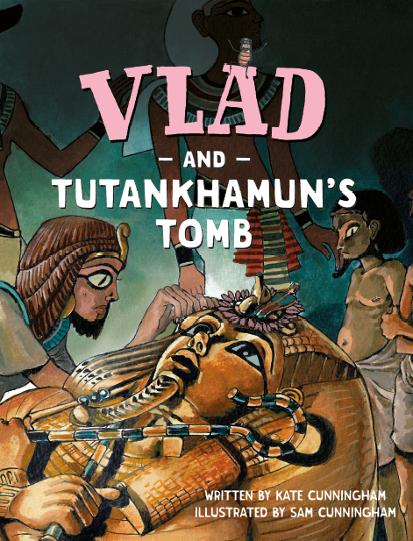
www.readingriddle.co.uk

