Slide 1
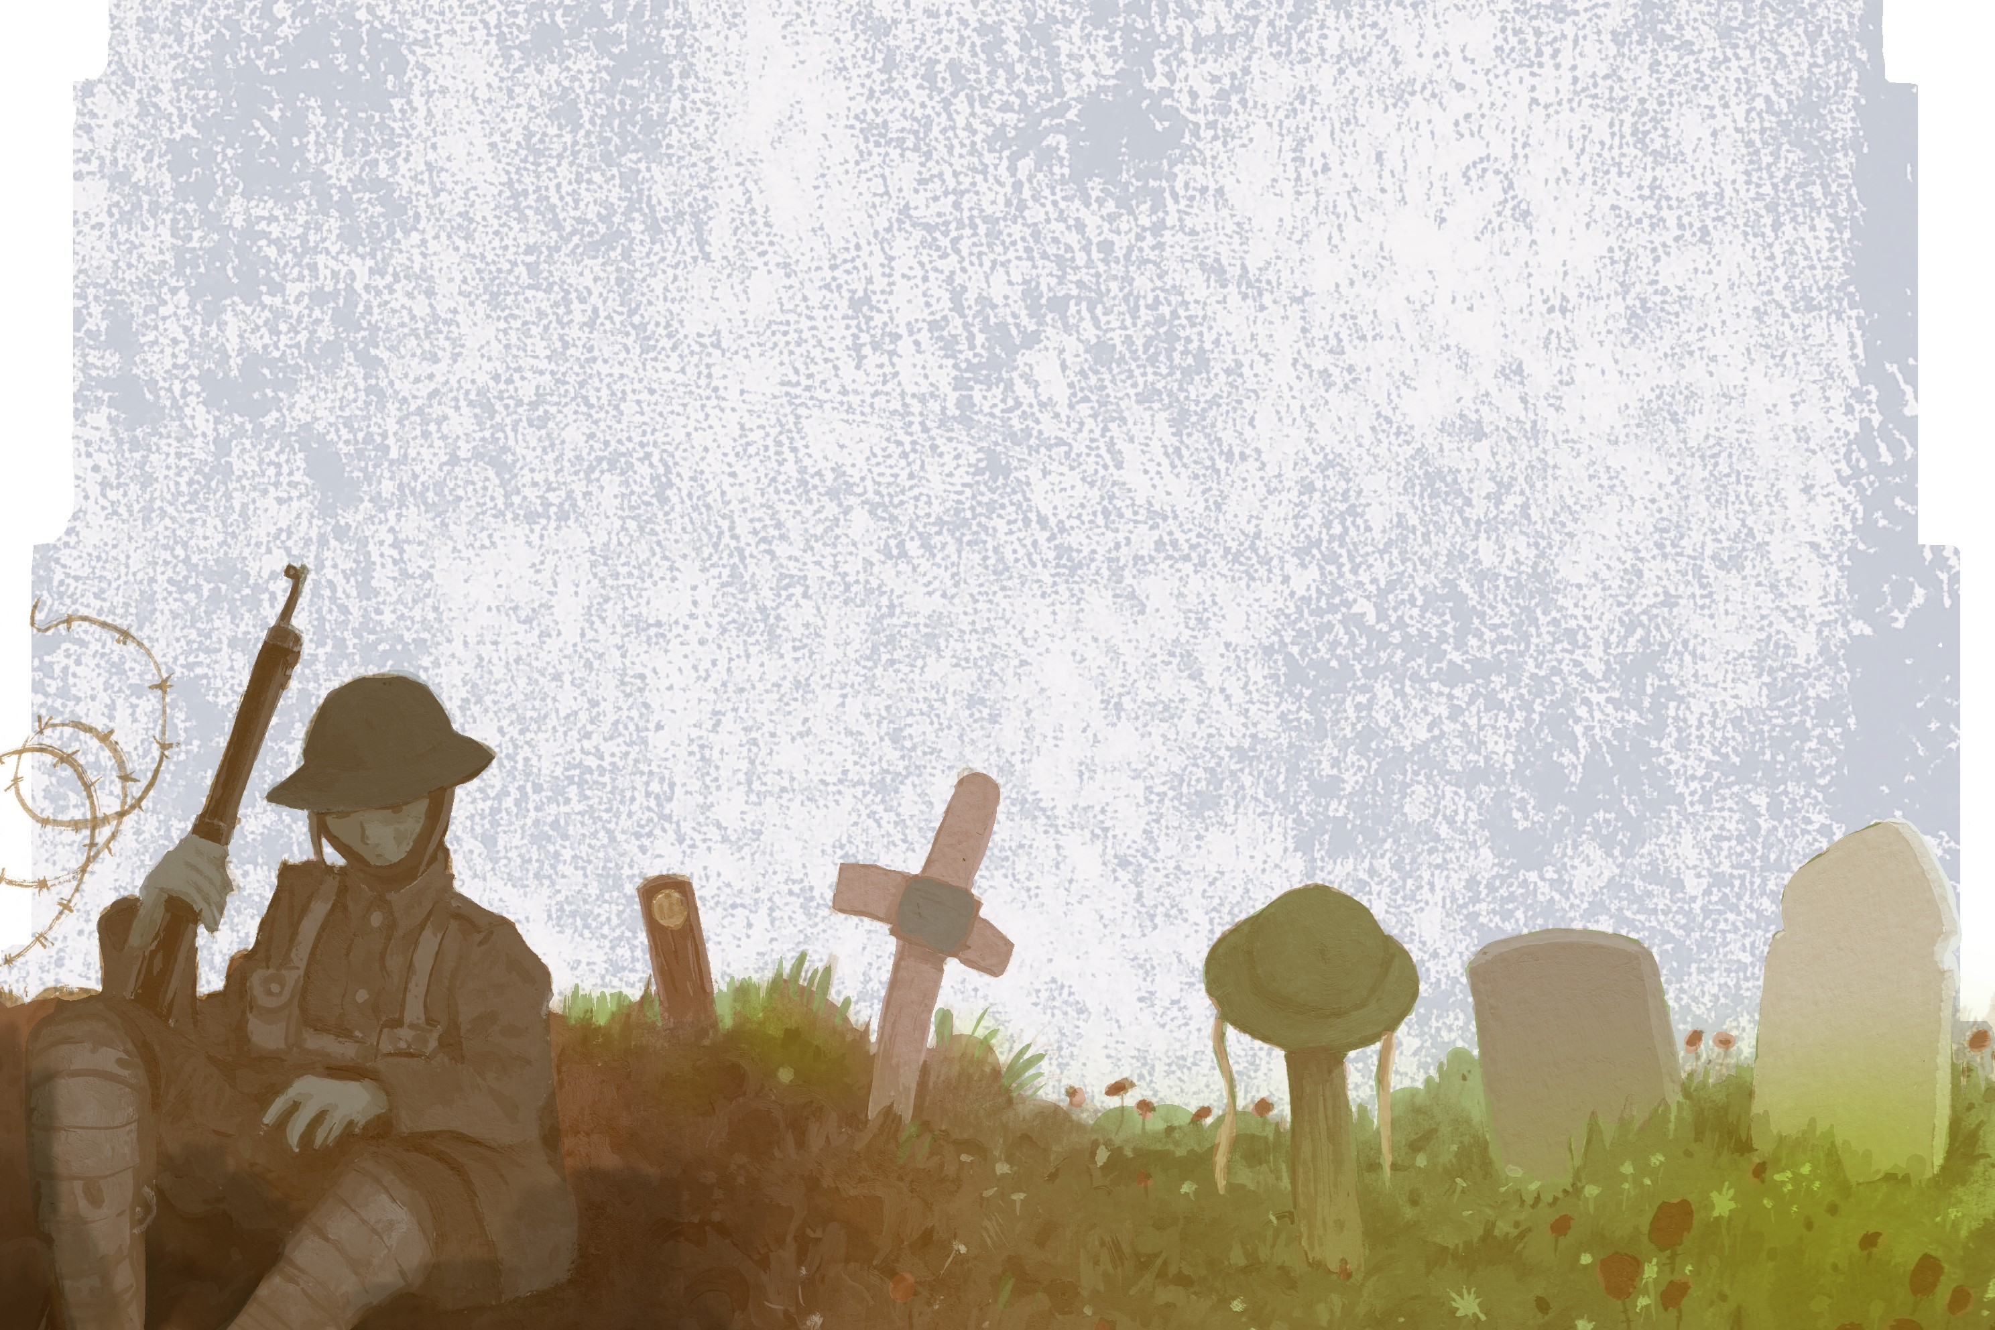
War Memorials
The following examples are just a very small number of the memorials that exist here and overseas.
They show the range of ideas used when designing a lasting reminder of the people and animals involved in conflicts.

Slide 2
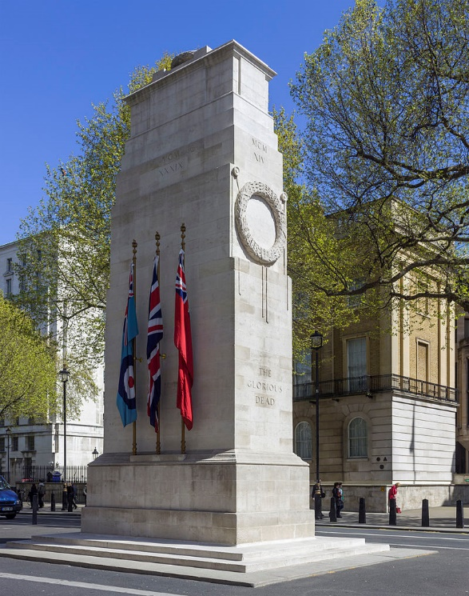
The Cenotaph
London
Designed in 1919 by Sir Edwin Lutyens, the Cenotaph was created to remember all the people lost in the First World War. It was purposely designed without any religious symbols on it.
It is estimated that around 1.2 million people visited after it was unveiled laying flowers and wreaths to those they had lost and within a week it was 3 metres deep in flowers.

Slide 3
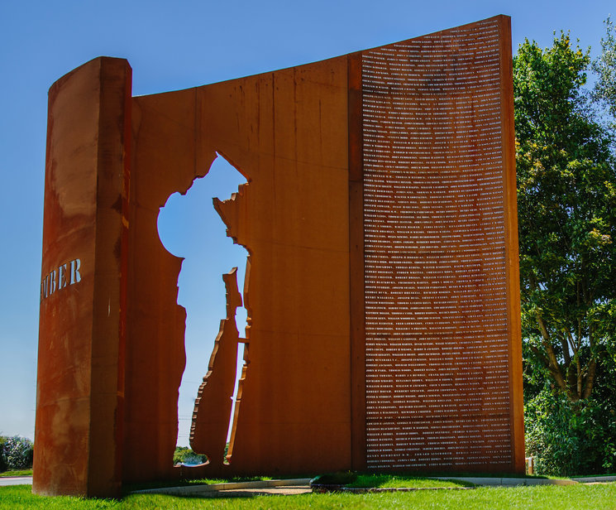
South Ribble
Created in 2016 this memorial is made out of steel.
It includes the names of the local men who died during World War One.

Slide 4
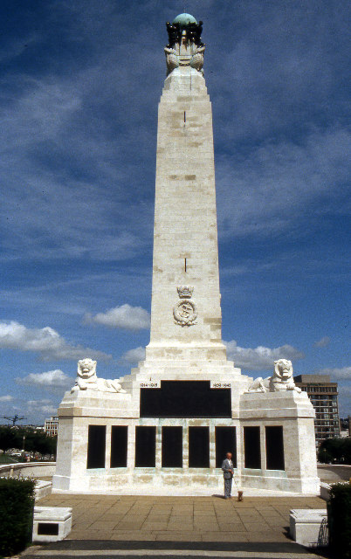
Plymouth Naval Memorial
This obelisk was designed after World War One and the garden was extended after World War Two.
The plaques include the names of sailors lost and buried at sea during the wars and it overlooks the sea at Pymouth Hoe.

Slide 5
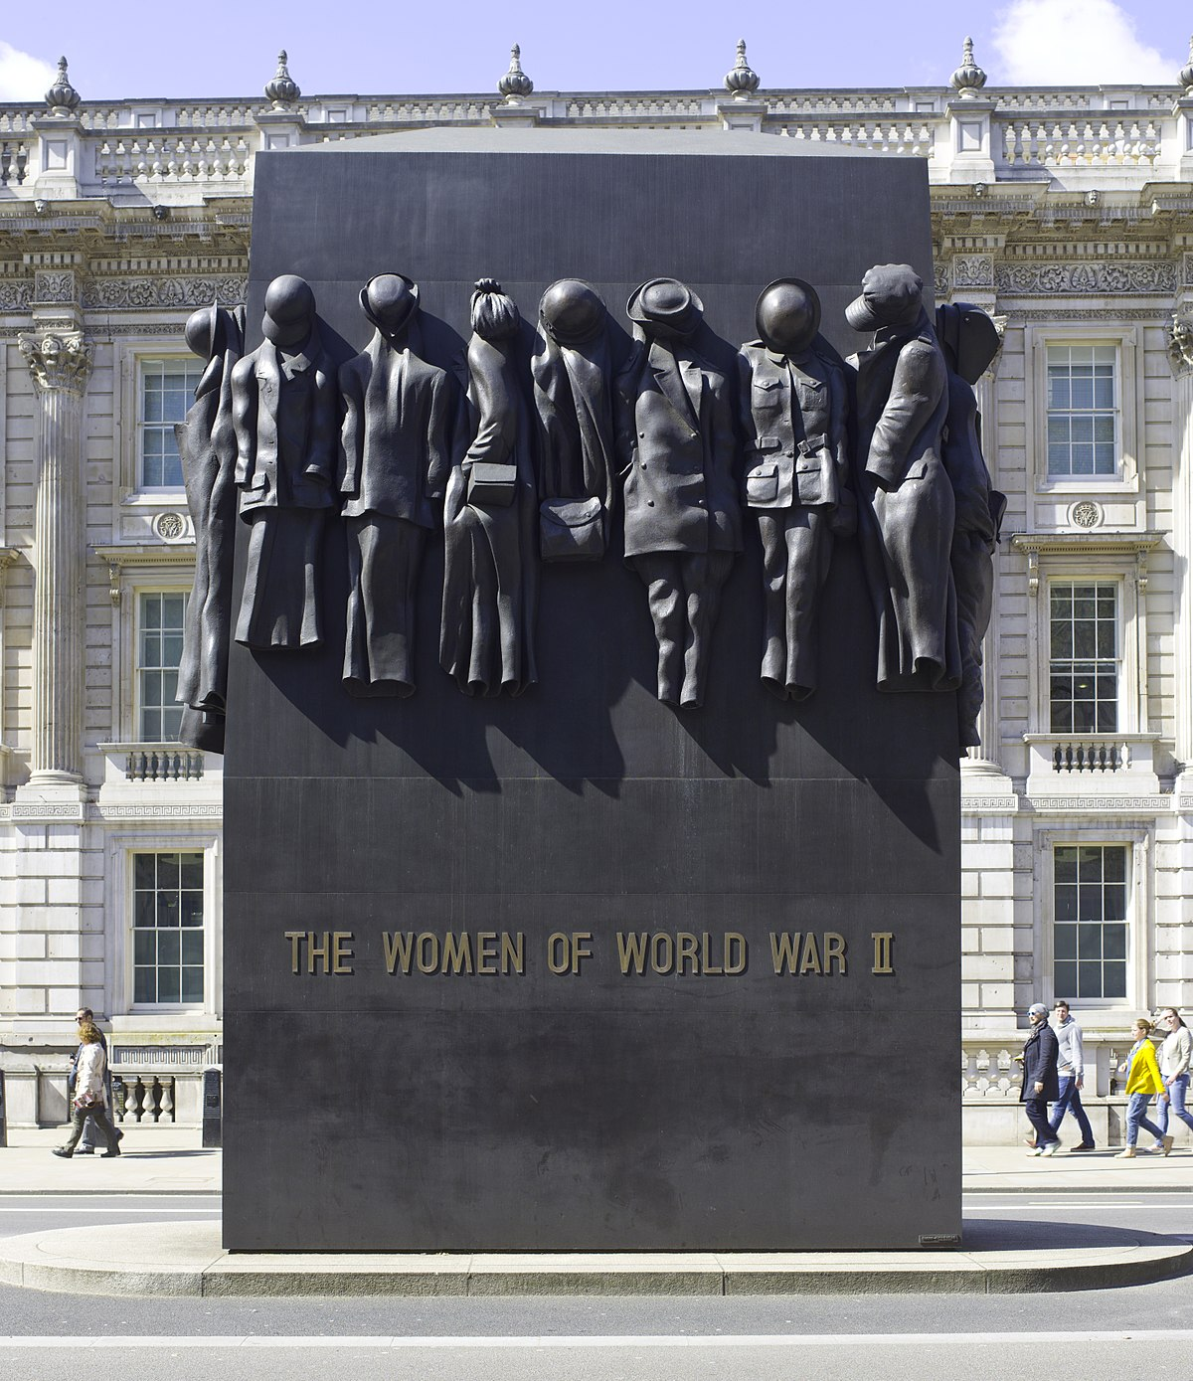
Memorial to the Women
This memorial was unveiled in 2005 to represent all the roles that women played during World War Two. It includes a welding mask, nurses uniform, police overall and uniform for the Land Army.
It is made of bronze and the lettering is the same as was used on ration books during the war.

Slide 6
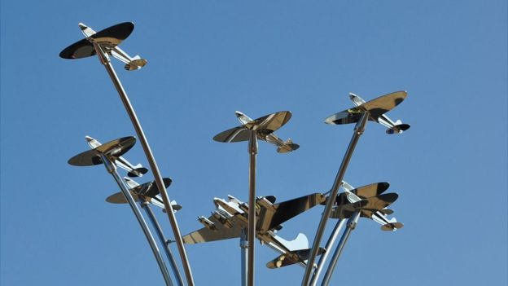
Aircrew memorial
Guernsey
This 6-metre-high memorial is outside Guernsey airport.
It was dedicated in 2015 and was created in memory to the aircrew who died around the Channel Islands.
It includes a US B-17 and 6 spitfires.

Slide 7
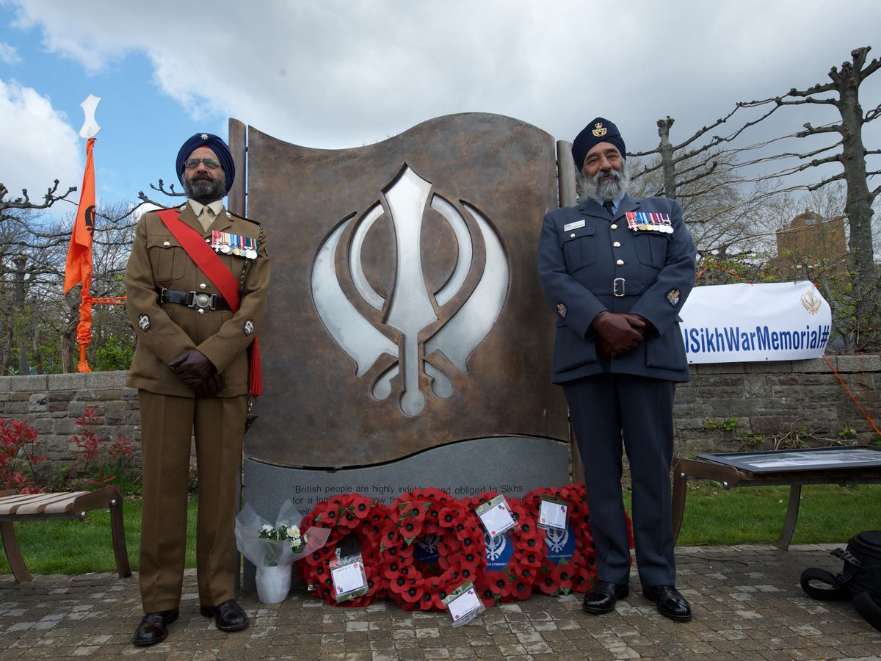
Sikh War Memorial
Bristol
In 2019 this memorial was dedicated to the memory of the Sikh soldiers who fought in World War One and World War Two.
It was created to remind people of the diversity of the armed forces from around the world.

Slide 8
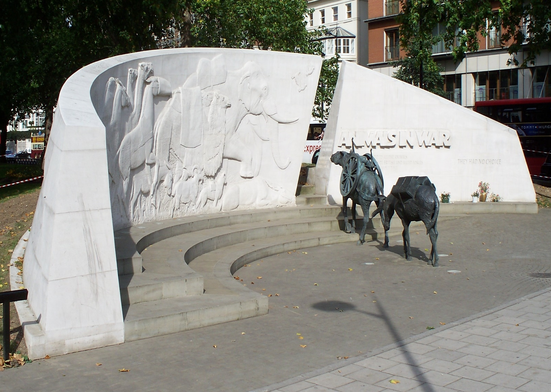
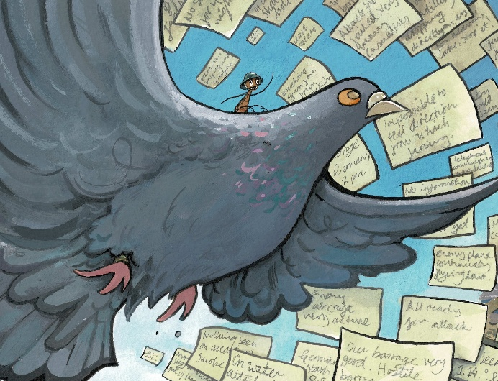
Animal Memorial
Hyde Park London
This memorial was unveiled in 2004 to represent all the animals who had no choice but were still involved in war.
There are two further bronze sculptures of a horse and a dog on the other side of the stone relief.

Slide 9
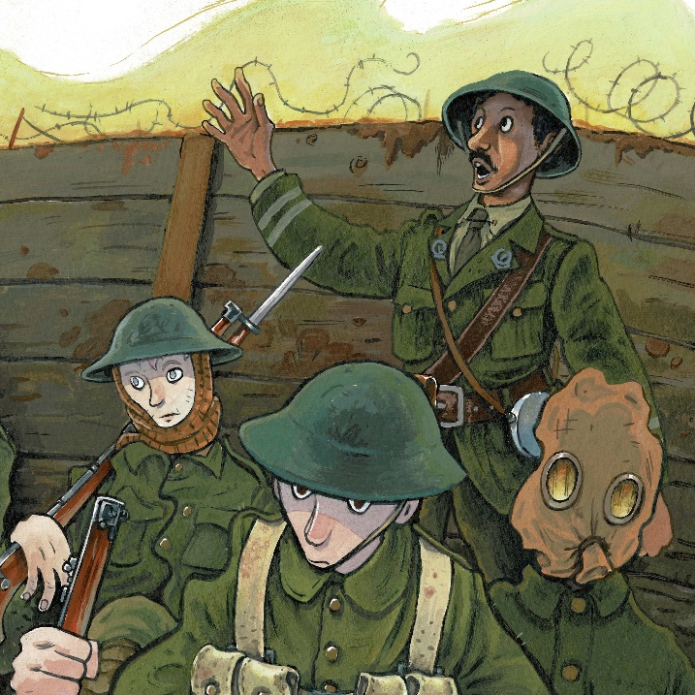
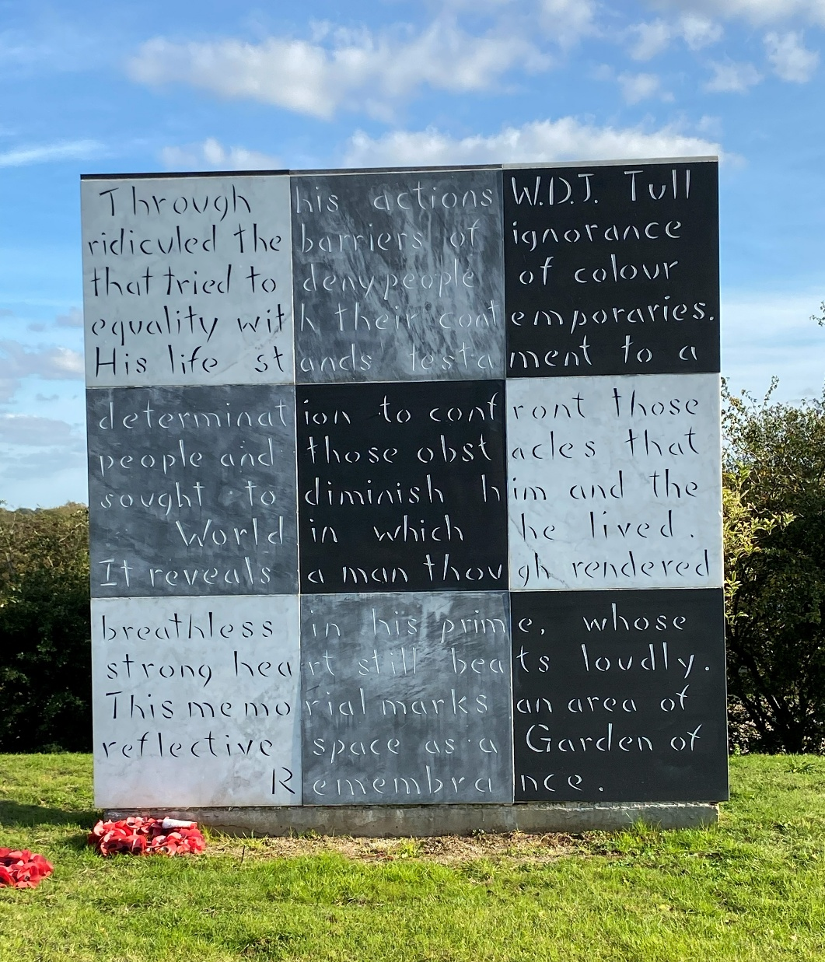
Memorial to
2nd Lieutenant Walter Tull
This memorial in Northampton remembers Walter Tull, who joined the Footballer’s Regiment.
The inscription remembers Walter’s fight as a soldier, but also as a Black British man who experienced prejudice and racism.

Slide 10
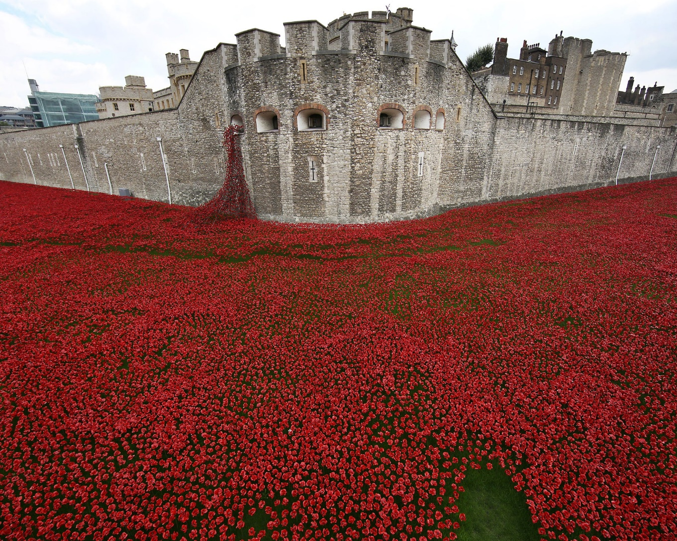
Poppies
Tower of London
These individual ceramic poppies were created by artist Paul Cummins and designer Tom Piper and were displayed at the Tower of London and then other venues around the country.
They were temporary but made a powerful and memorable impact during the centenary years after World War One.

Slide 11
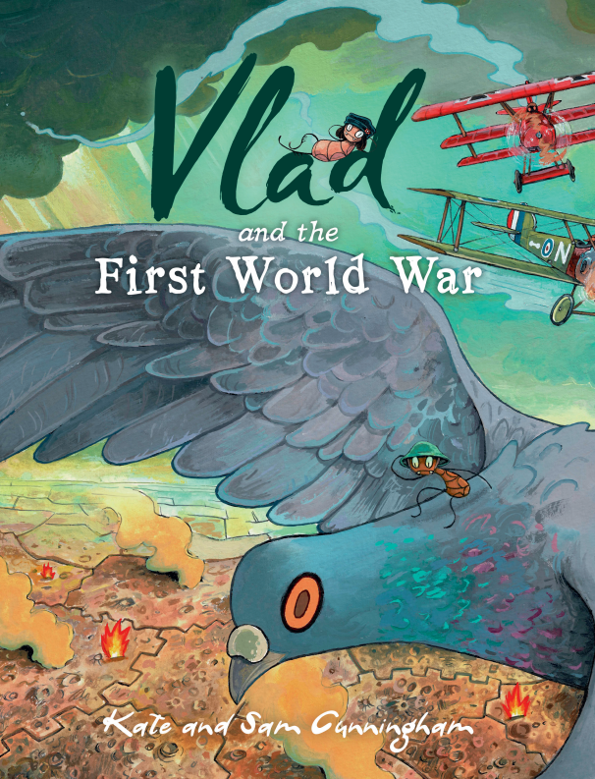
For information about
Vlad and the First World War
visit
www.readingriddle.co.uk

