Slide 1
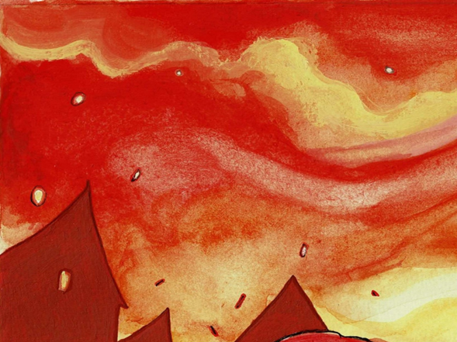
After the Great Fire of London
Learning objective:
To identify the similarities and differences between refugees in 1666 and now.
The following extracts are taken from Vlad and the Great Fire of London by Kate and Sam Cunningham ©

Slide 2
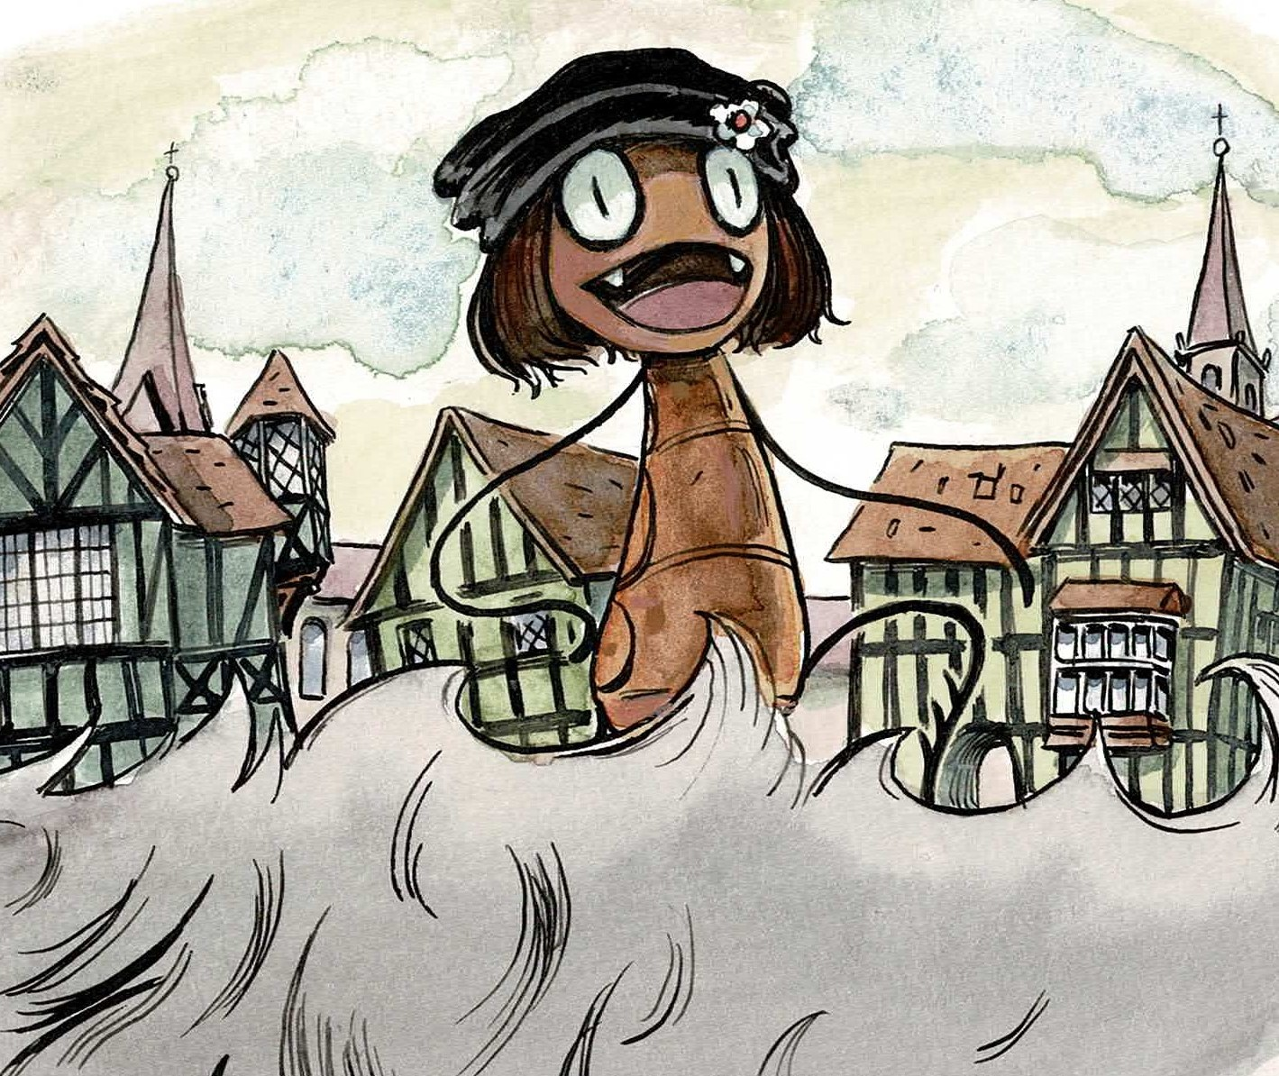
We saw what happened before, during and after the Great Fire of London. This is part of our story.

Slide 3

People had to rescue things that were precious or important to them.
What is this?
What’s in the locked box?

Slide 4
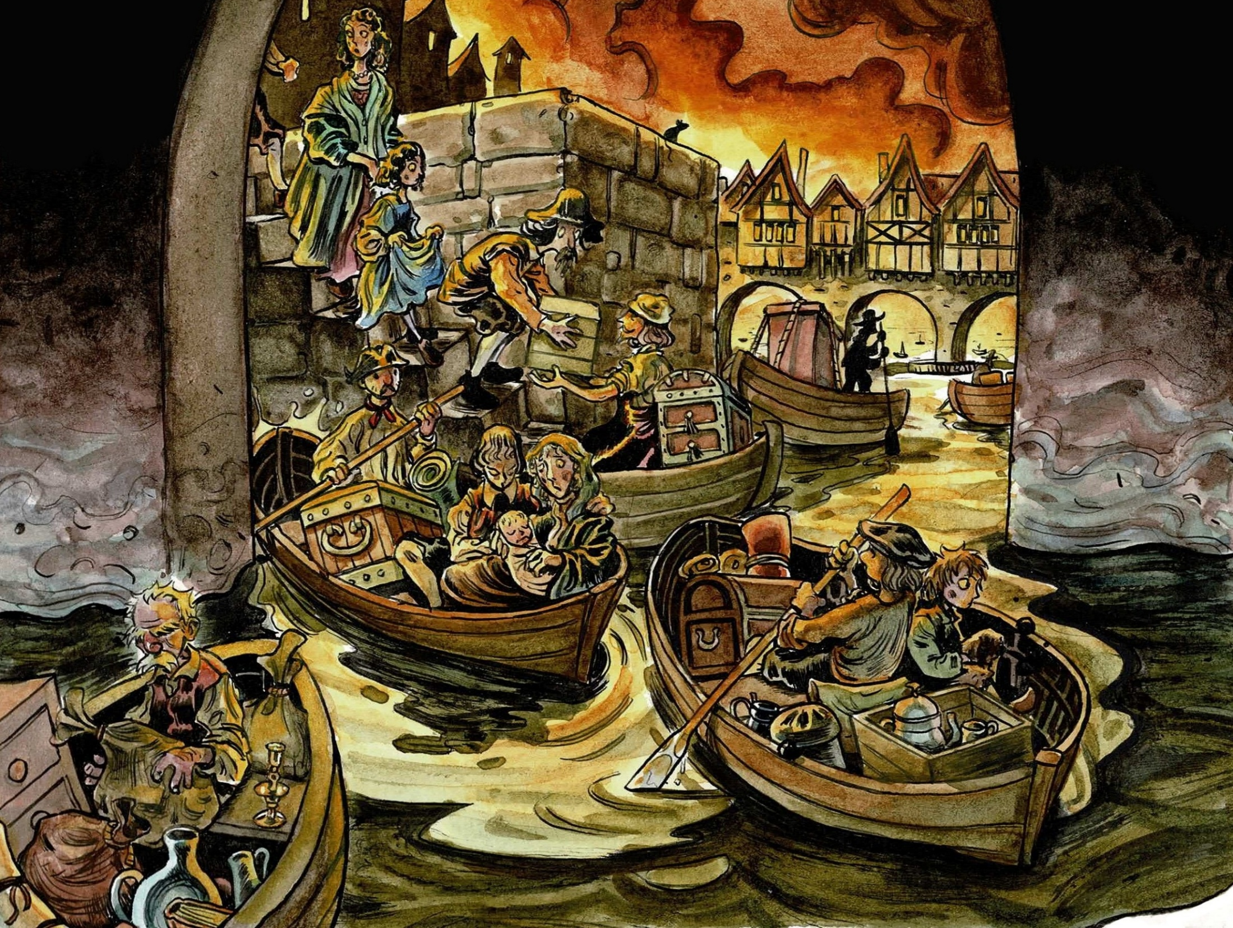
What transport did people use in this slide and the last one?

Slide 5
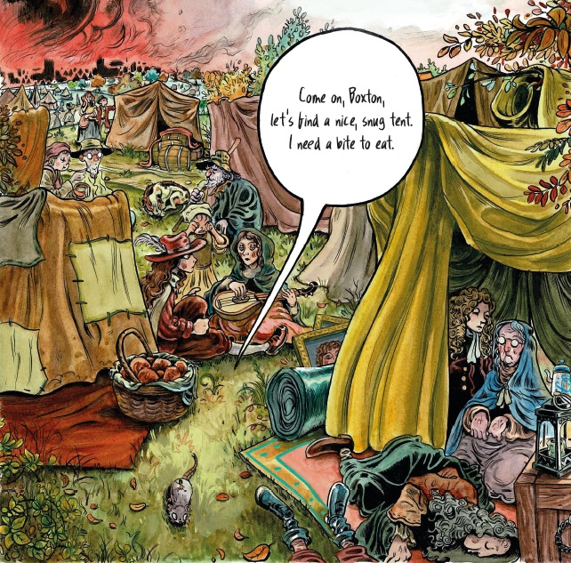
Ahead of us were fields. People put down their belongings and started to make shelters out of blankets.

Slide 6
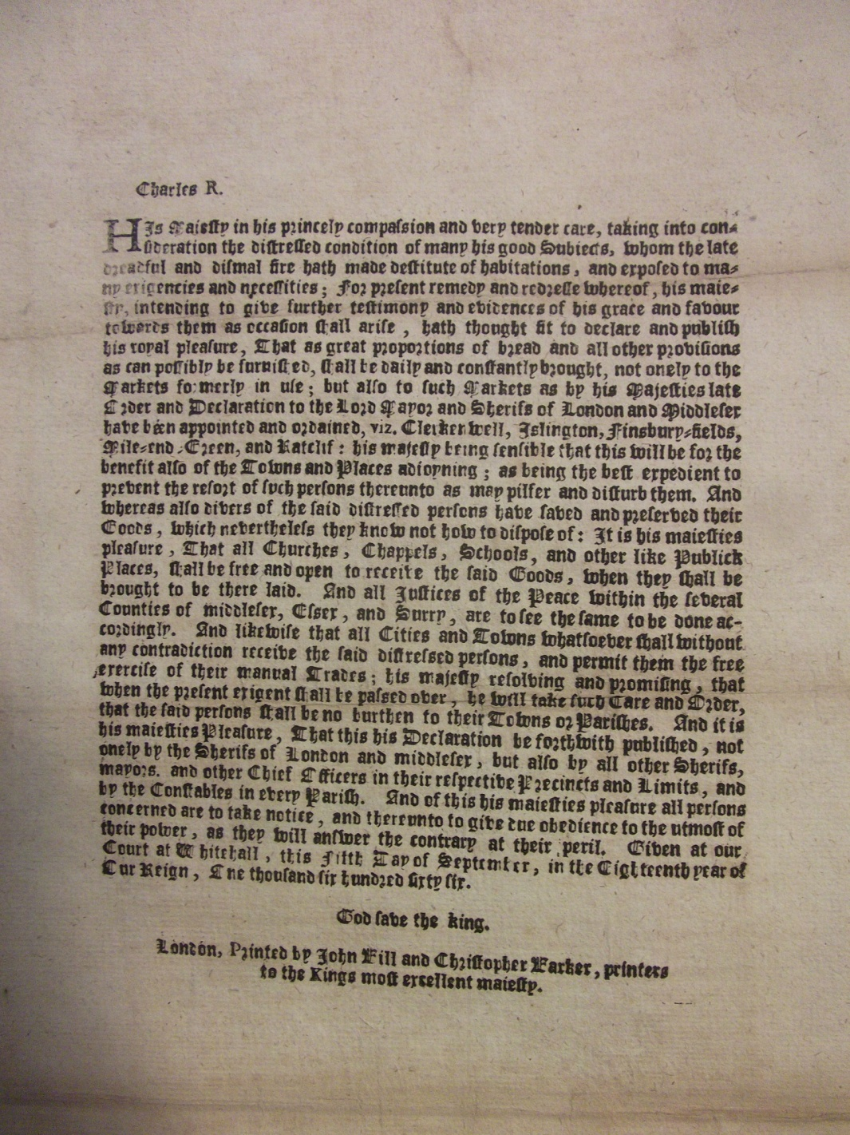
King Charles II made a proclamation

Slide 7
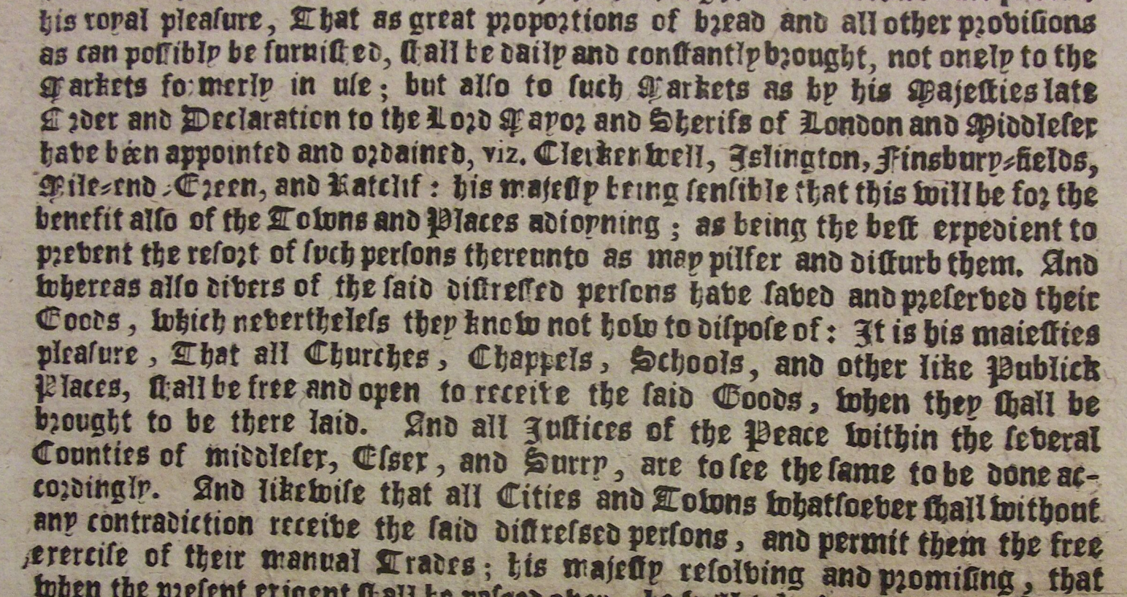
In this King Charles says:
1. that bread must be brought to the fields in Clerkenwell, Islington,
Finsbury and Mile End to feed the refugees.
2. that churches, chapels and schools must help lock up possessions so they are not stolen.
3. that these areas must help people work to earn money.
1
2
3

Slide 8
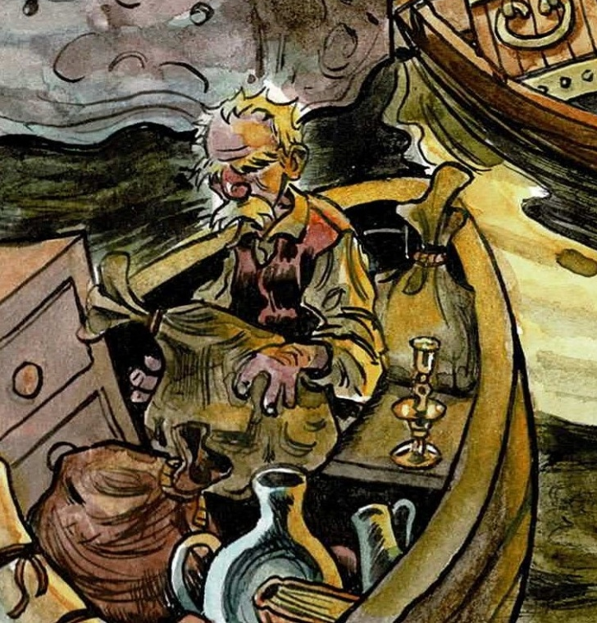
In 1666 what did people carry away from the fire?

Slide 9
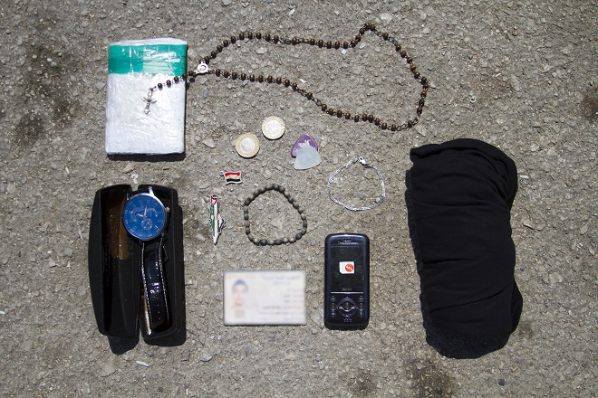
What might someone take today?

Slide 10
I can show at least three similarities and differences between things that people would save in 1666 and now.
Similarities Things that people would save both in 1666 and now | Differences Things that people would only save in 1666 or now. Label when they could save them.

Slide 11
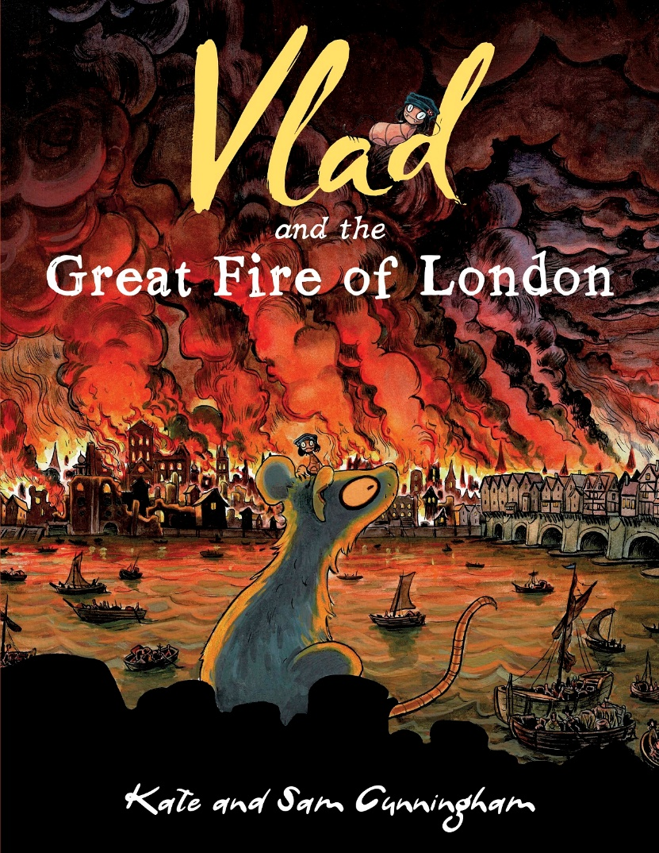
If you enjoyed hearing from Vlad you can read the whole story in:

