Slide 1
What did the ancient Egyptians achieve?

Slide 2
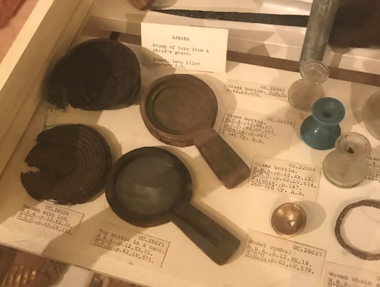
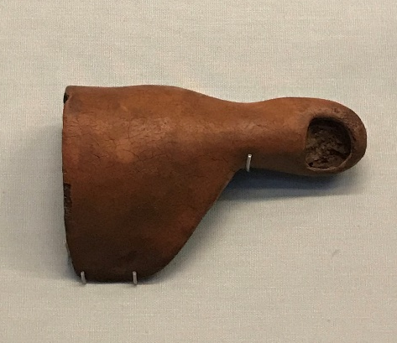
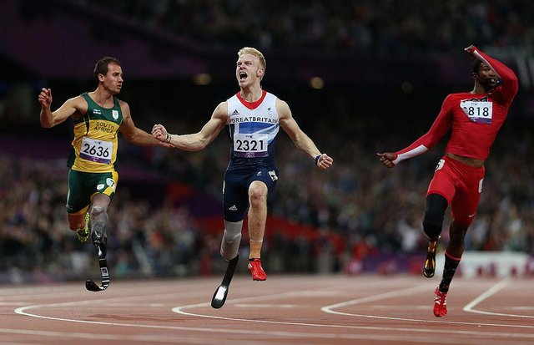

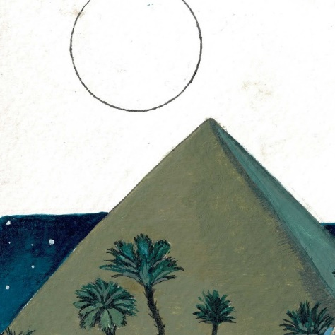
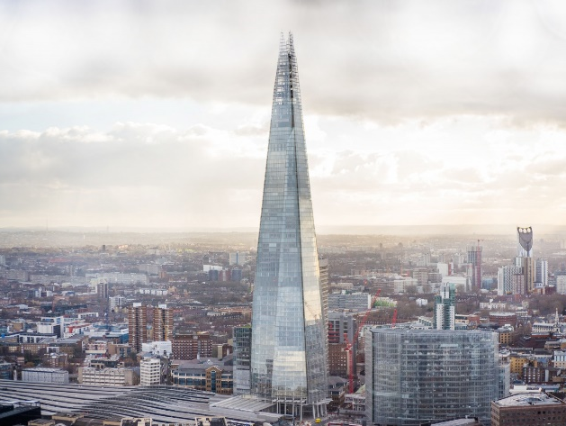
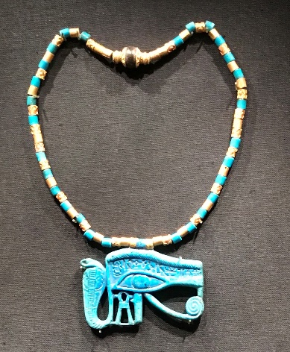
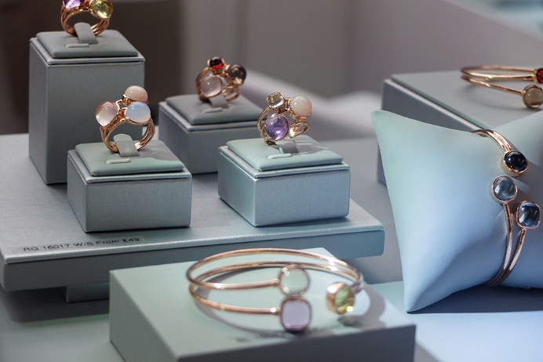
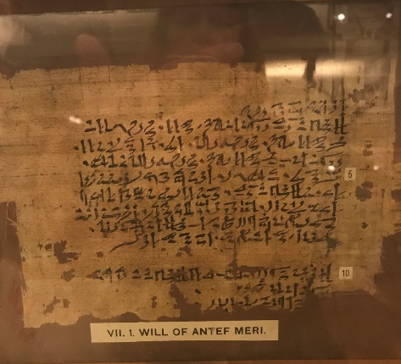
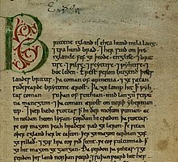
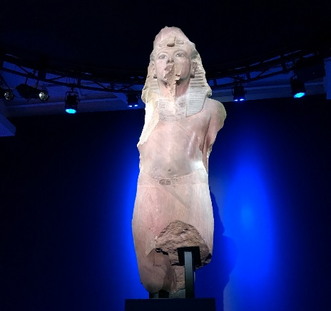
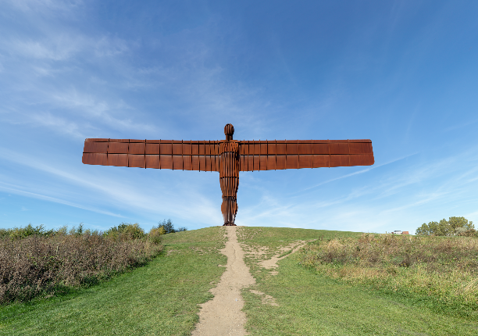
Medicine
Cosmetics
Jewellery
Construction
Sculpture
Written texts

Slide 3
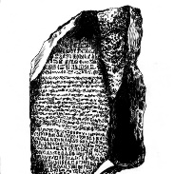
For many centuries we lost the ability to read hieroglyphic writing.
The discovery of the Rosetta Stone enabled linguists to start decoding it as this has the same text in 3 languages. The first 2 languages were already known, and the third was hieroglyphs. This was the key to the puzzle!

Slide 4
Simplified hieroglyphs

Slide 5
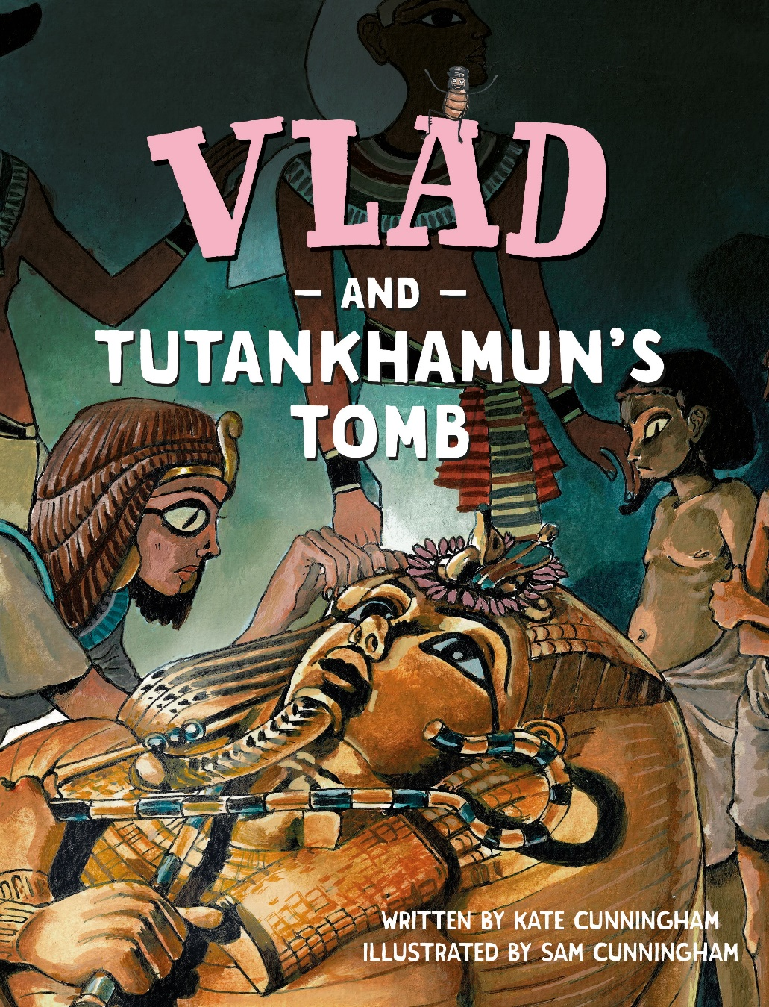
www.readingriddle.co.uk

