Slide 1
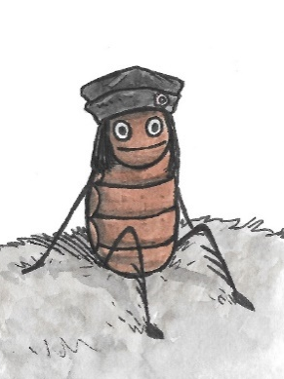
A flea in history
www.readingriddle.co.uk
How did Florence Nightingale improve data collecting?

Slide 2
Florence Nightingale knew that a big hospital needed accurate records.
She worked for many hours into the night writing down information about everybody and everything happening.

Slide 3
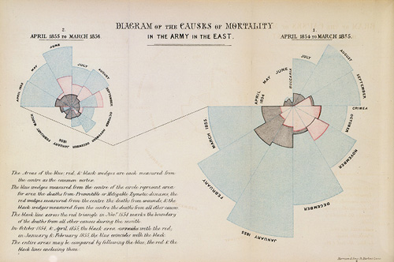
In particular she recorded information about the patients so she could see which of her changes were helping or which made no difference.

Slide 4
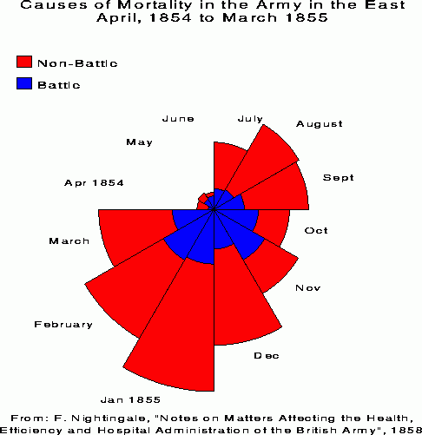
These diagrams are called coxcombs and are like pie charts, except that they record more detailed information over time.

Slide 5
This made it easier to see information quickly and compare data.
Which month had the most deaths altogether?
January
Which month did least men die of wounds from battle?
April
Why would there be more patients with wounds some months?
It would depend if there had been a big battle in the Crimean War

Slide 6
In 1858 Florence Nightingale was the first woman to be elected as a member of the Royal Statistical Society.
All hospitals and doctors now keep careful records recording what happens to patients. It is essential when trialling new medicines and treatments to decide if they work and should continue to be used.

Slide 7
