Slide 1
Amulets

Slide 2
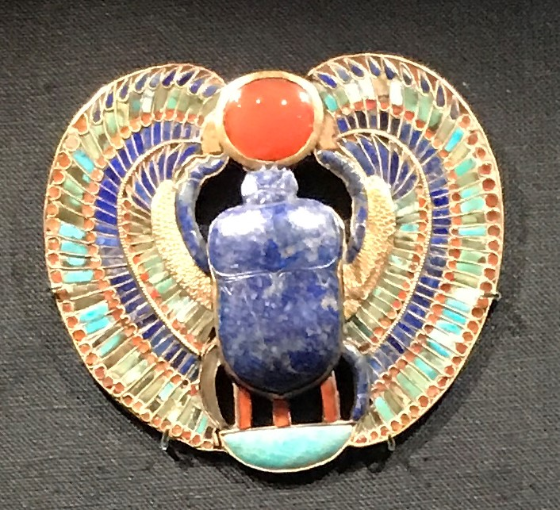
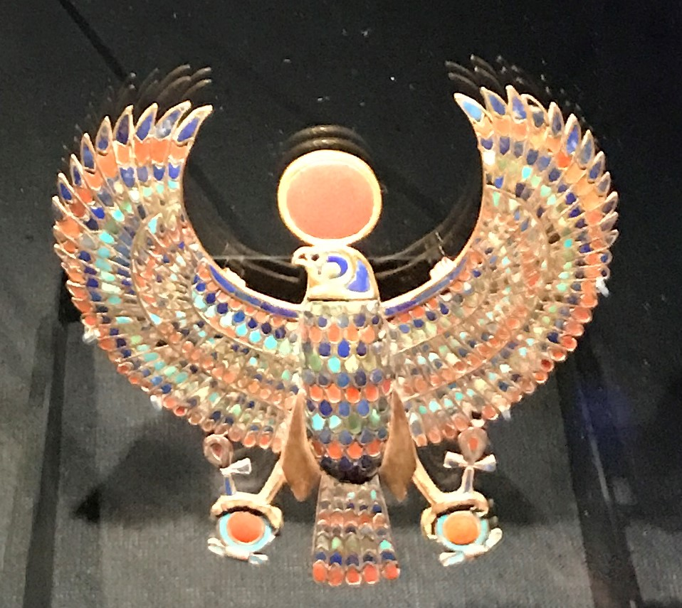
Scarab beetle pushing the sun across the sky. Scarabs represented rebirth and regeneration.
A falcon, crowned with the sun. The claws are holding a shen sign which represents eternity.

Slide 3
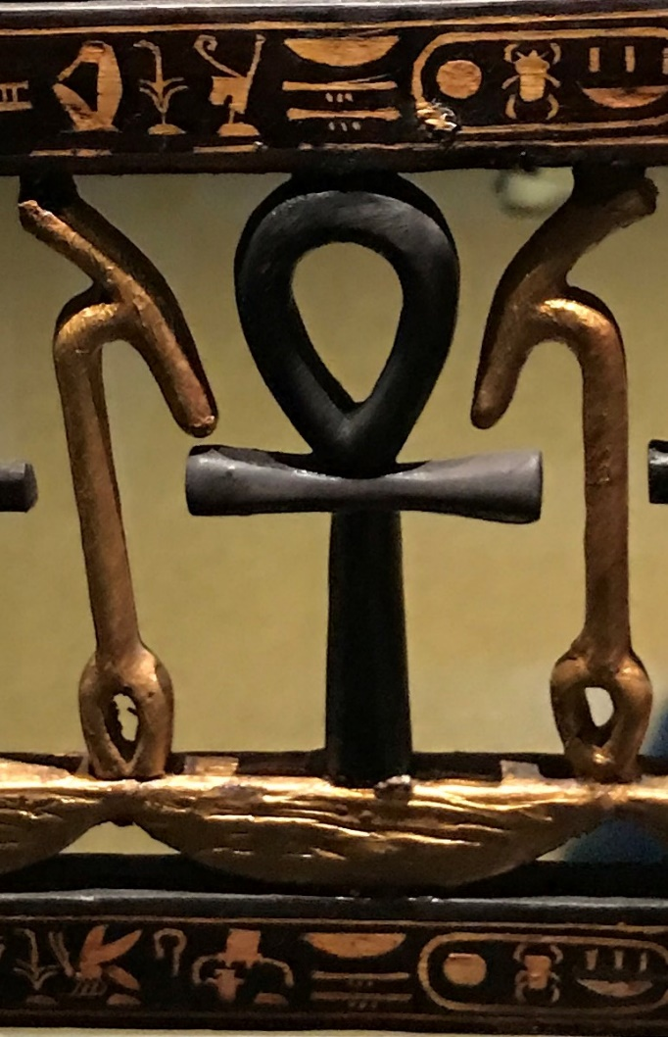
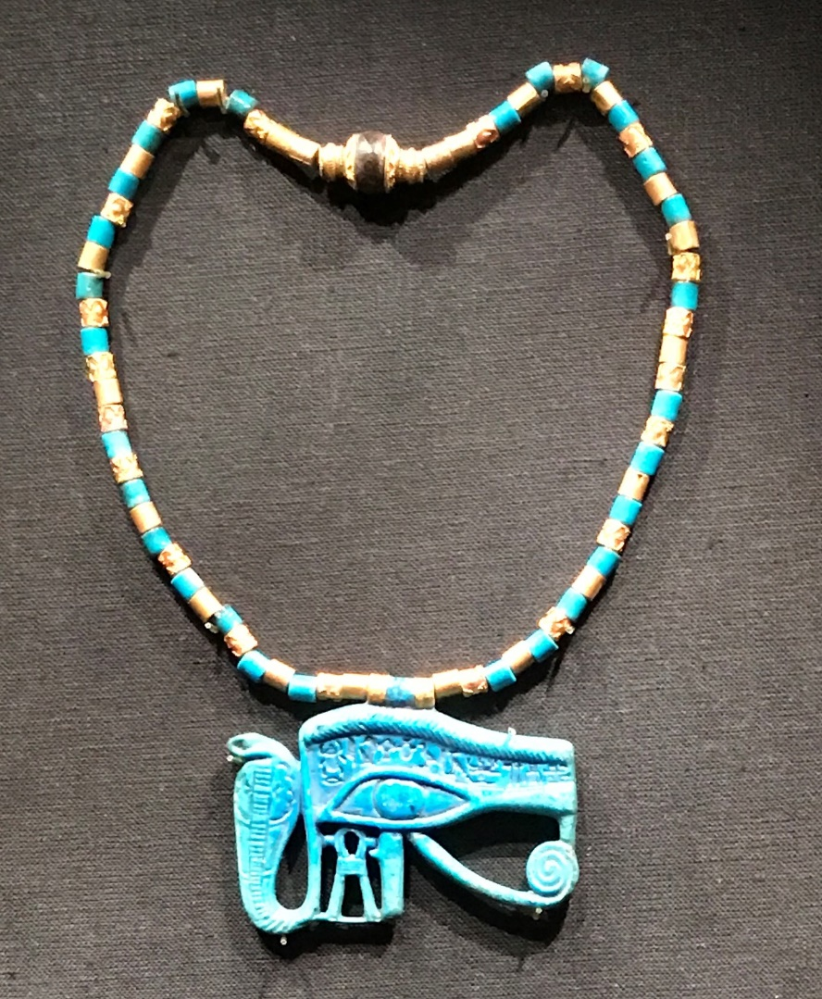
Wooden carved ankh which symbolises life.
Faience* necklace of the eye of Horus – a symbol of protection.
* glaze made from crushed quartz and sand

Slide 4
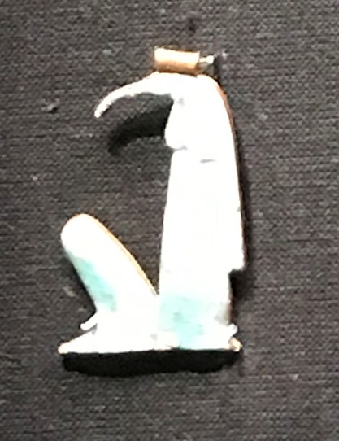
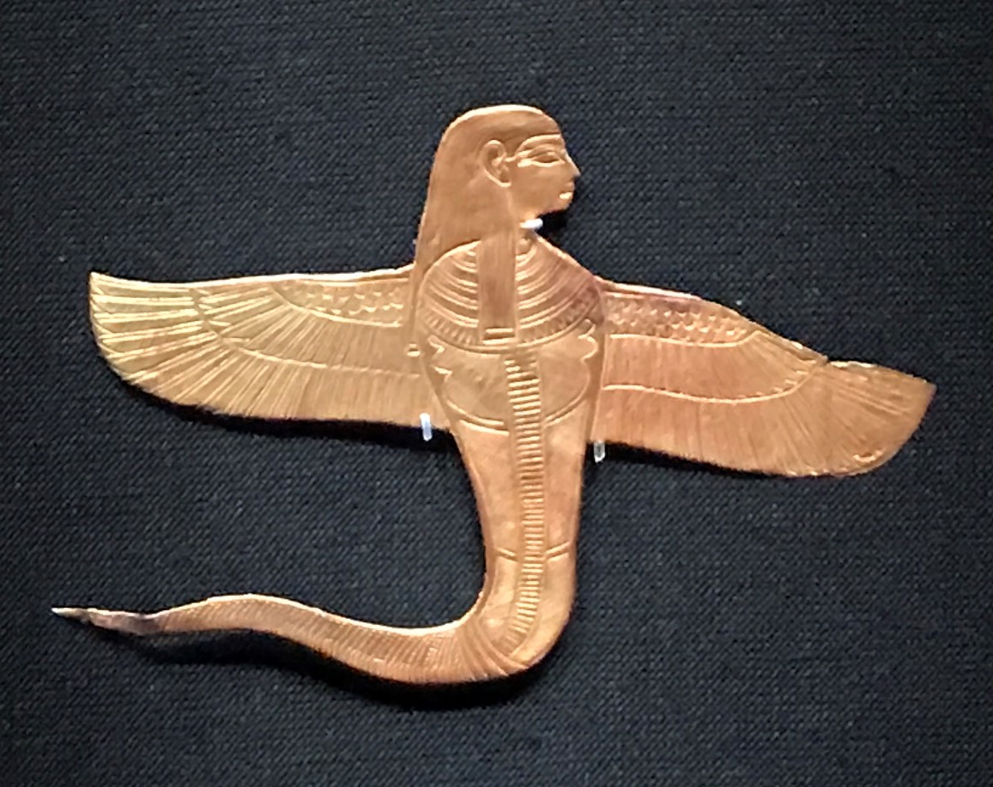
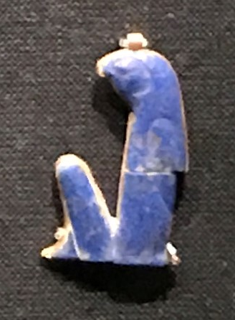
Green feldspar* amulet of the god Thoth.
Golden amulet representing a goddess of magic.
Lapis lazuli** amulet of the god Horus.
* Feldspar is a type of rock used to make glass and ceramics
** lapis lazuli is a semi precious stone

Slide 5
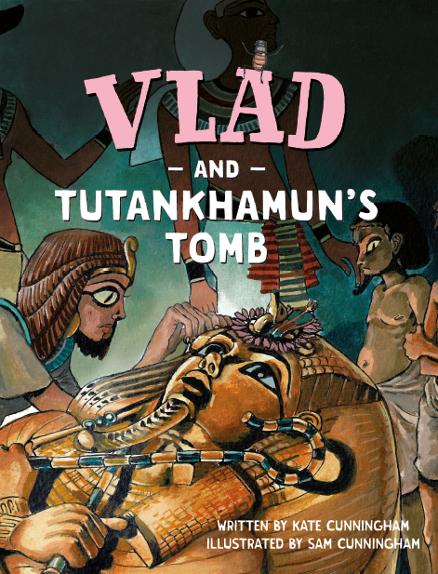
www.readingriddle.co.uk

