Slide 1
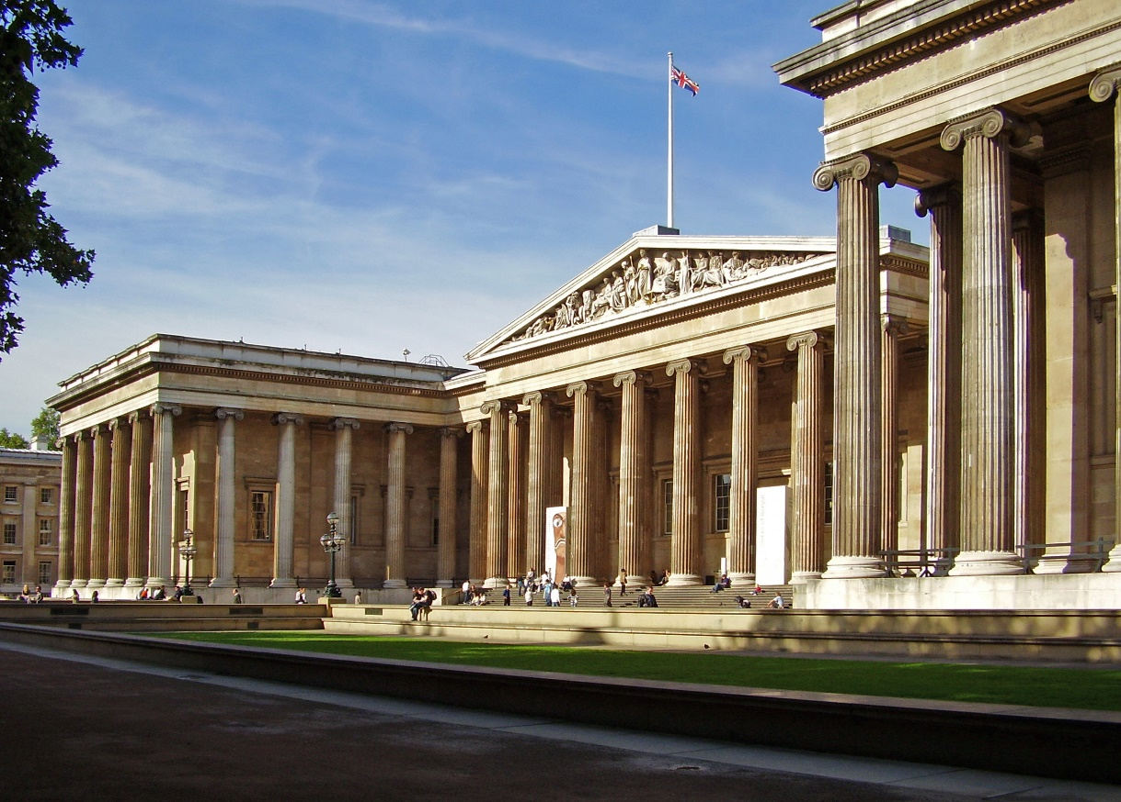
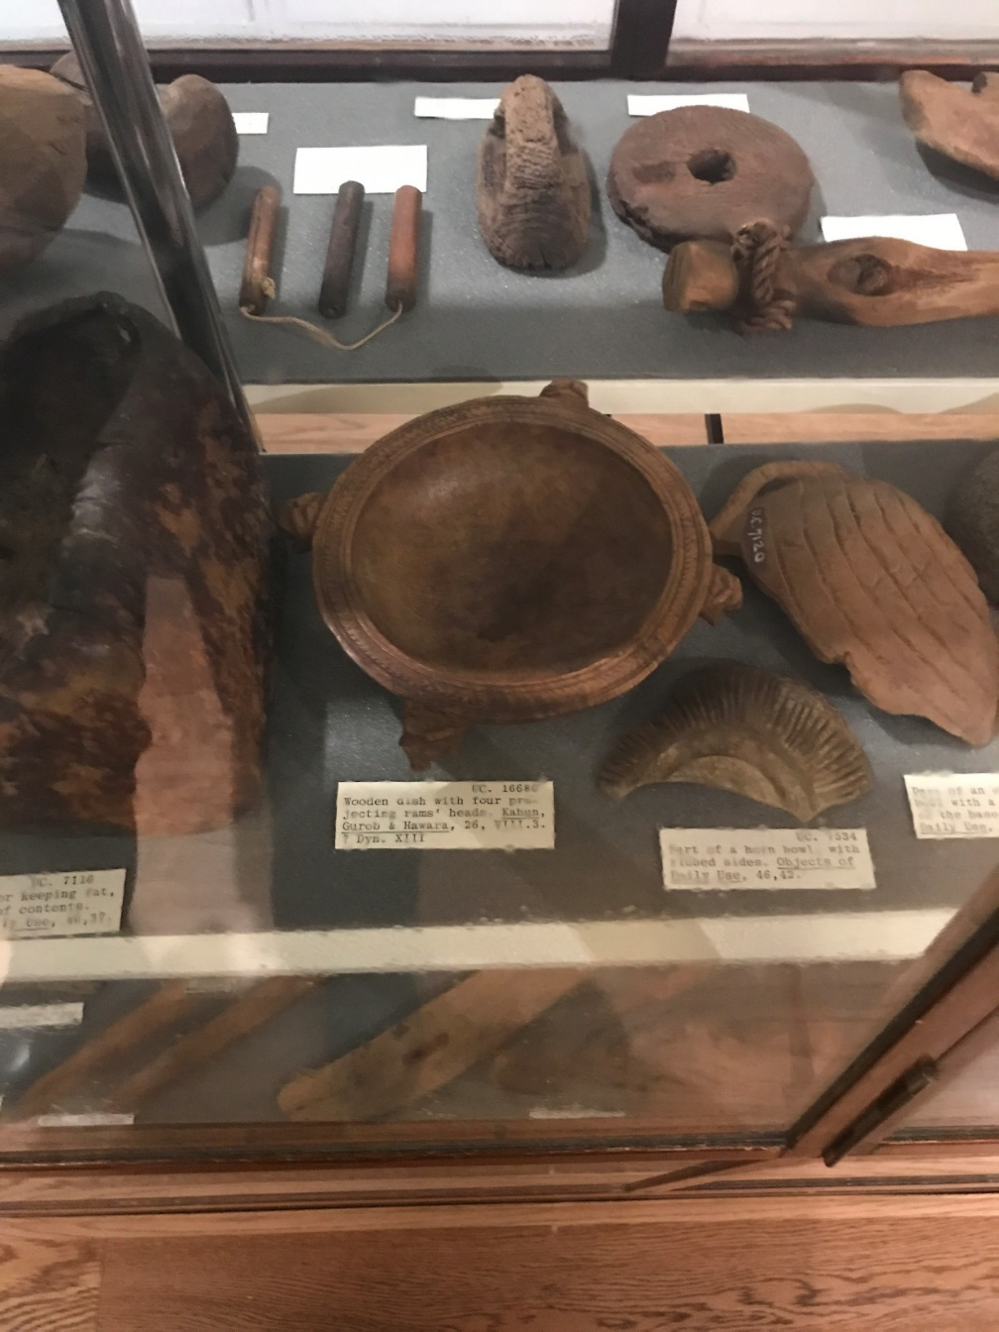
The British Museum
Where are you if you see this?
The Petrie Museum

Slide 2
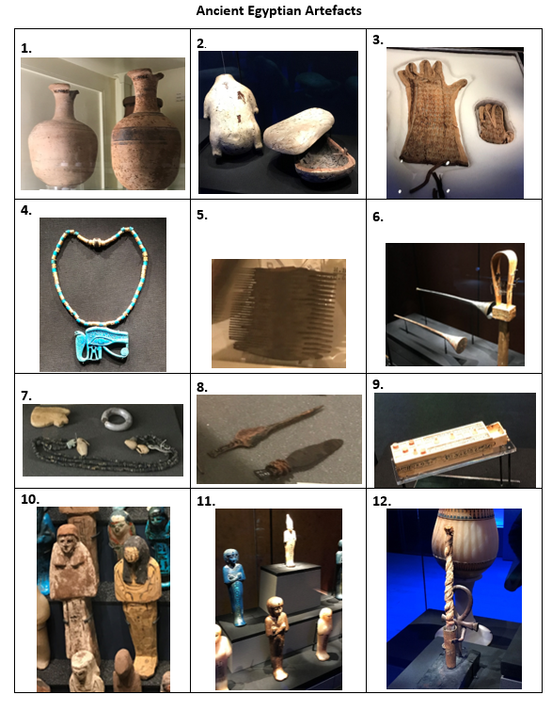

Slide 3

www.readingriddle.co.uk

