Slide 1
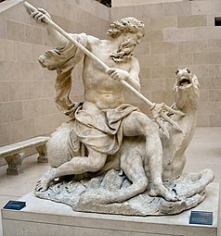
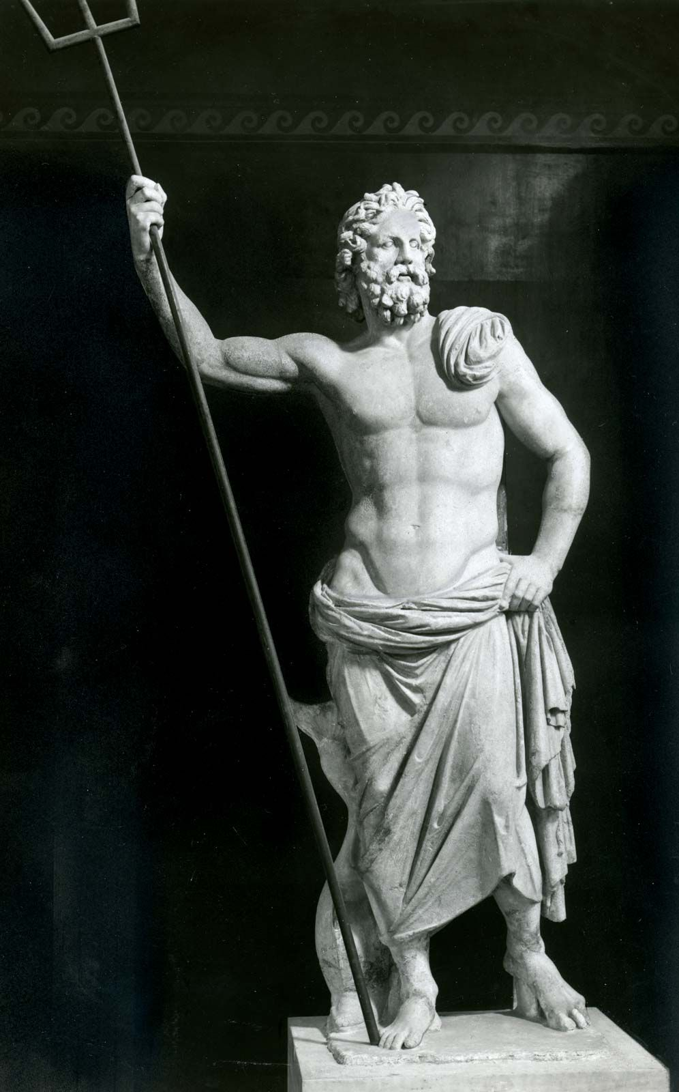
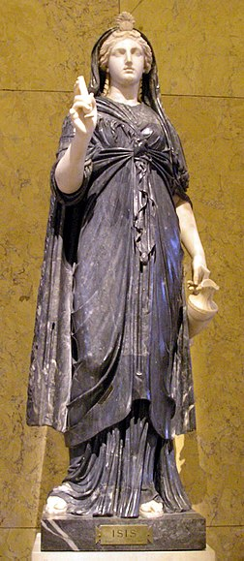
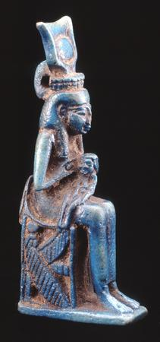
Did different civilisations affect each other?
Roman
Roman
Egyptian
Greek
Neptune
Poseidon
Goddess Isis
Goddess Isis

Slide 2
Number
of years
If 100 years
= 1cm
Civilisation
calculation
Ancient Egyptian: 3,070 BCE → 30 CE
Ancient Roman: 750 BCE → 500 CE
Ancient Greek: 1,100 BCE → 300 CE
Mayan: 600 BCE → 850 CE
Dynastic Chinese: 2,100 BCE → 200 CE
3,070 + 30
3,100 years
31cm
750 + 500
1,250 years
12.5cm
1,100 + 300
1,400 years
14cm
600 + 850
1,450 years
14.5cm
2,100 + 200
2,300 years
23cm

Slide 3
 |  |  |  |  | 3,000 BCE |  |  |  |  | 2,500 BCE |  |  |  |  | 2,000 BCE |  |  |  |  | 1,500 BCE |  |  |  |  | 1,000 BCE |  |  |  |  |  | 500 BCE |  |  |  |  |  |  |  |  |  | 500 |  |  |  |  | 1,000
Dynastic China
Mayan
Ancient Greece
Ancient Rome
Ancient Egypt
Ancient Egyptian: 3,070 BCE → 30 CE
Ancient Roman: 750 BCE → 500 CE
Ancient Greek: 1,100 BCE → 300 BCE
Mayan: 600 BCE → 850 CE
Dynastic Chinese: 2,100 BCE → 200 CE

Slide 4
 |  |  |  |  | 3,000 BCE |  |  |  |  | 2,500 BCE |  |  |  |  | 2,000 BCE |  |  |  |  | 1,500 BCE |  |  |  |  | 1,000 BCE |  |  |  |  |  | 500 BCE |  |  |  |  |  |  |  |  |  | 500 |  |  |  |  | 1,000
Alexander the Great defeated
Queen Cleopatra defeated
Ancient Greece
Ancient Rome
Ancient Egypt
Ancient Egyptian: 3,070 BCE → 30 CE
Ancient Roman: 750 BCE → 500 CE
Ancient Greek: 1,100 BCE → 300 BCE

