Slide 1
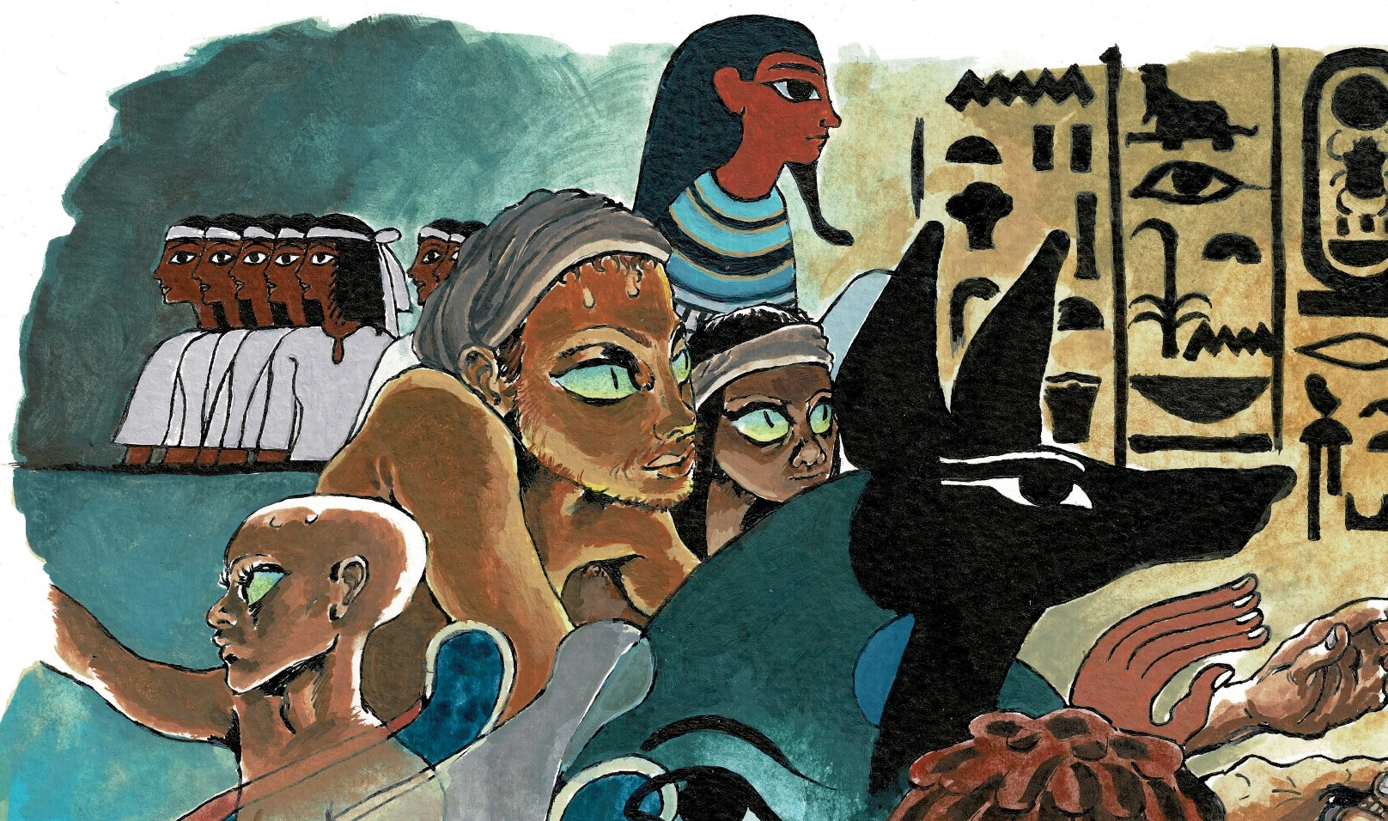
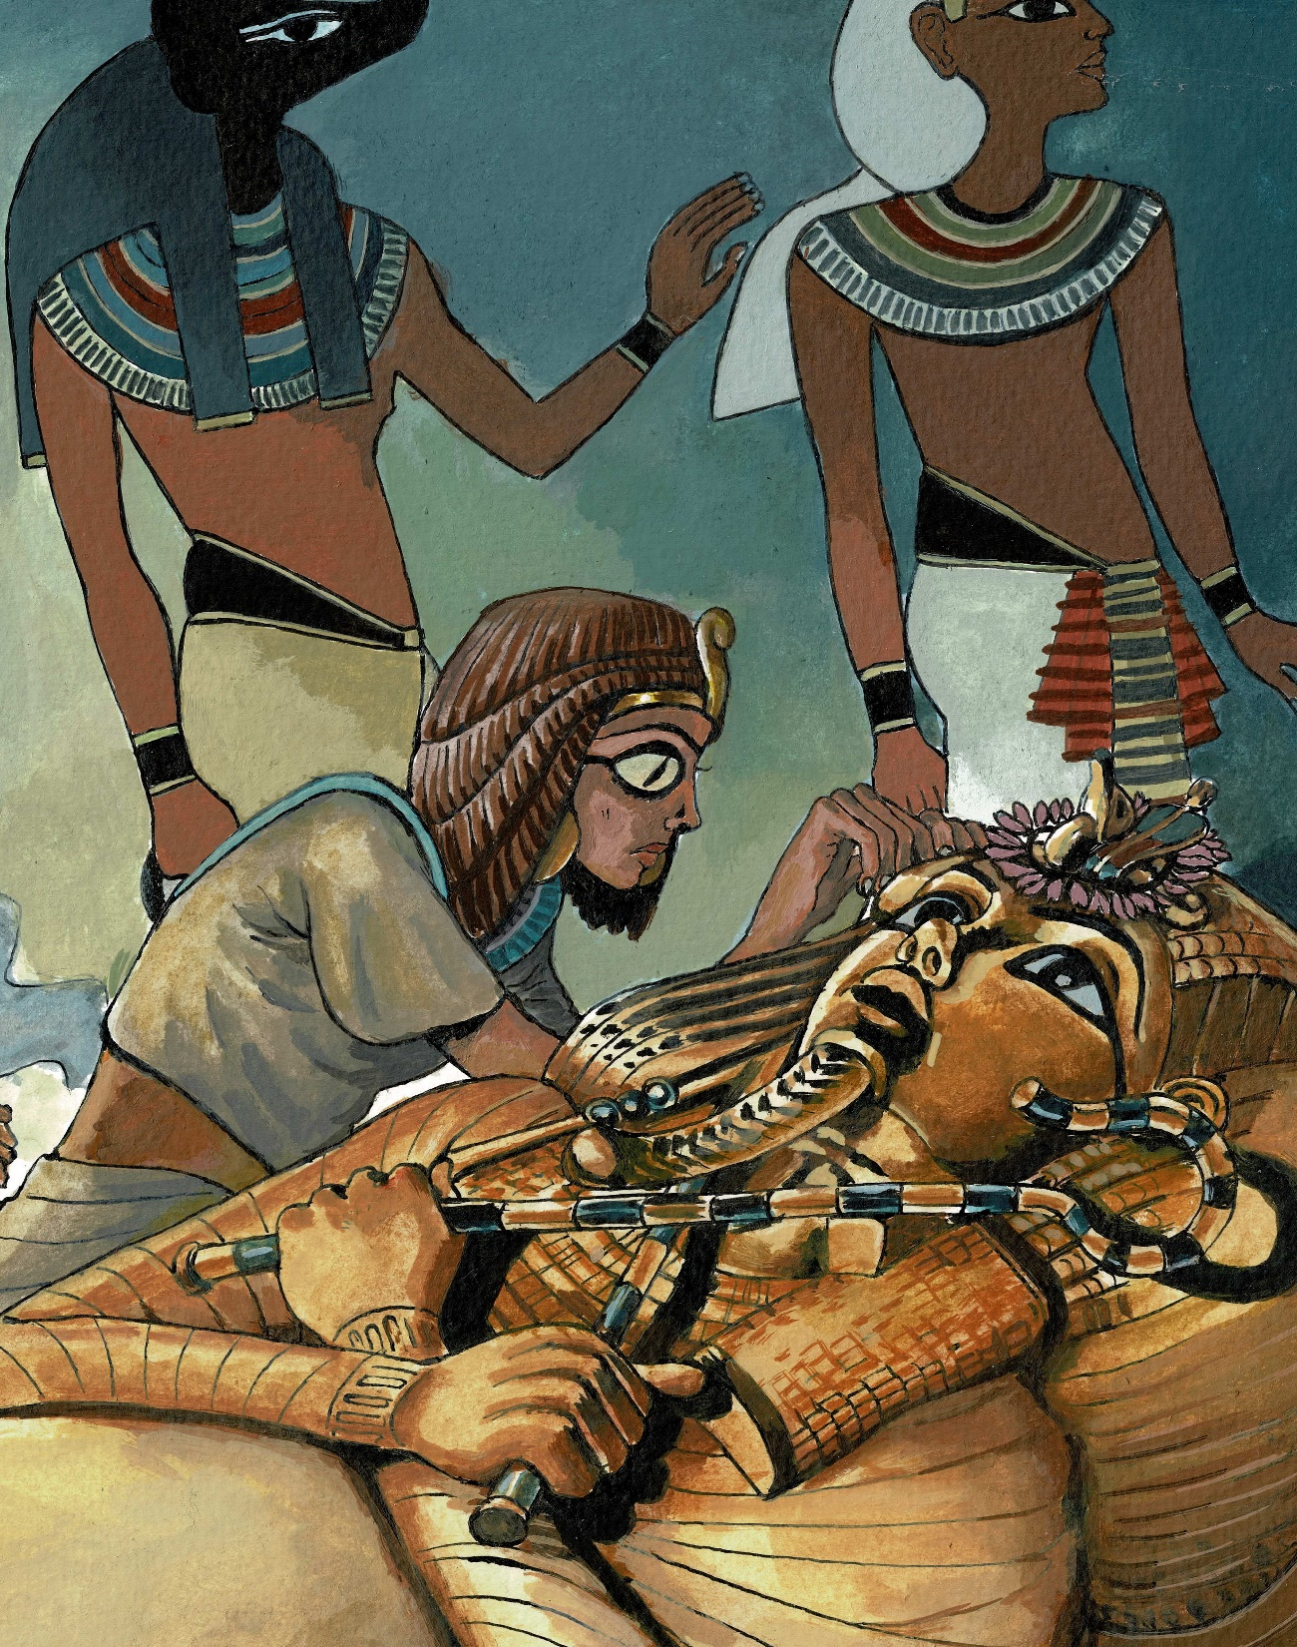
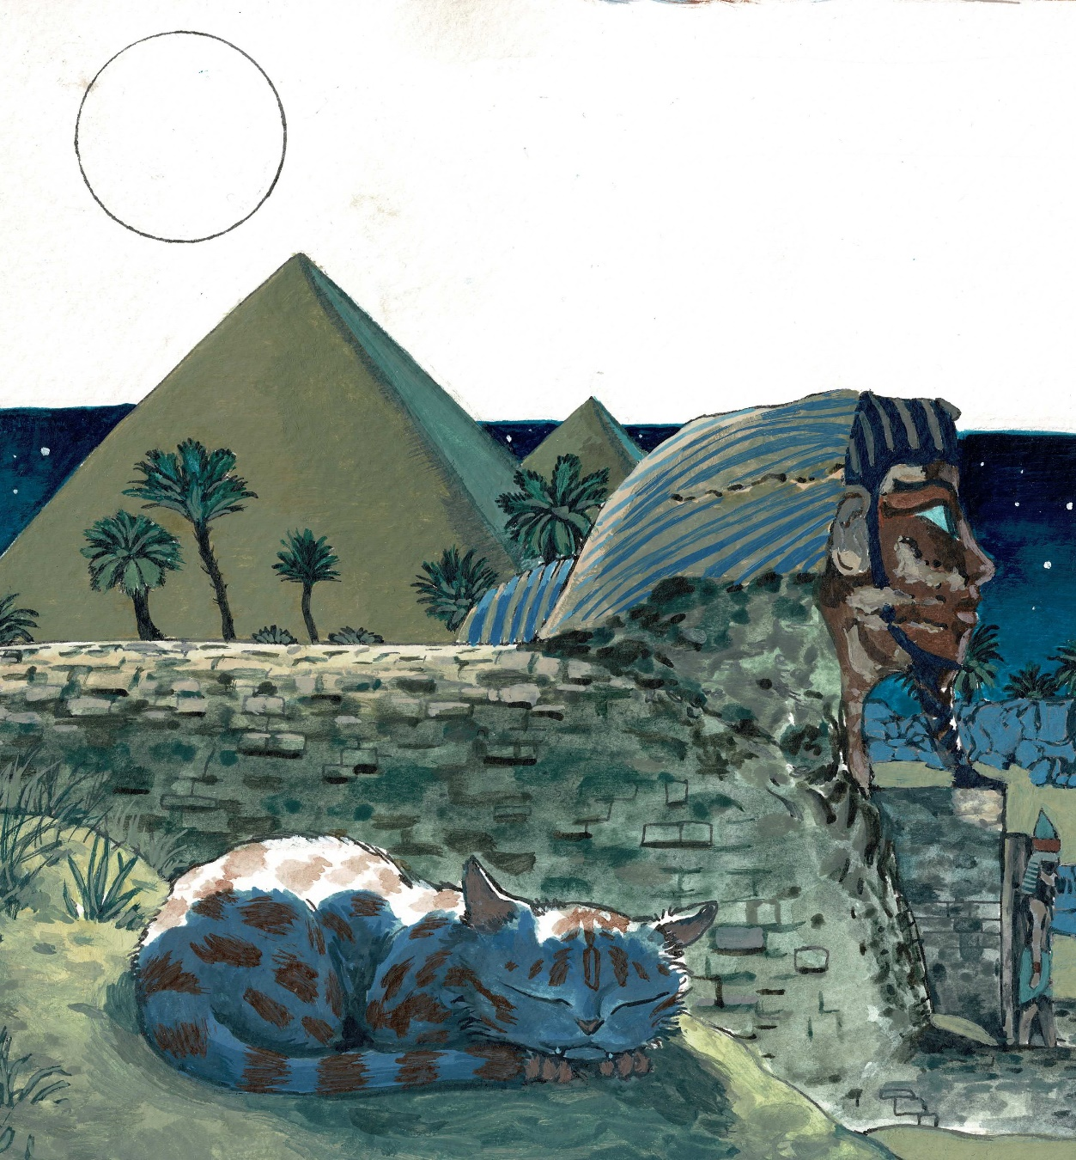
What group of people are we studying in history?

Slide 2
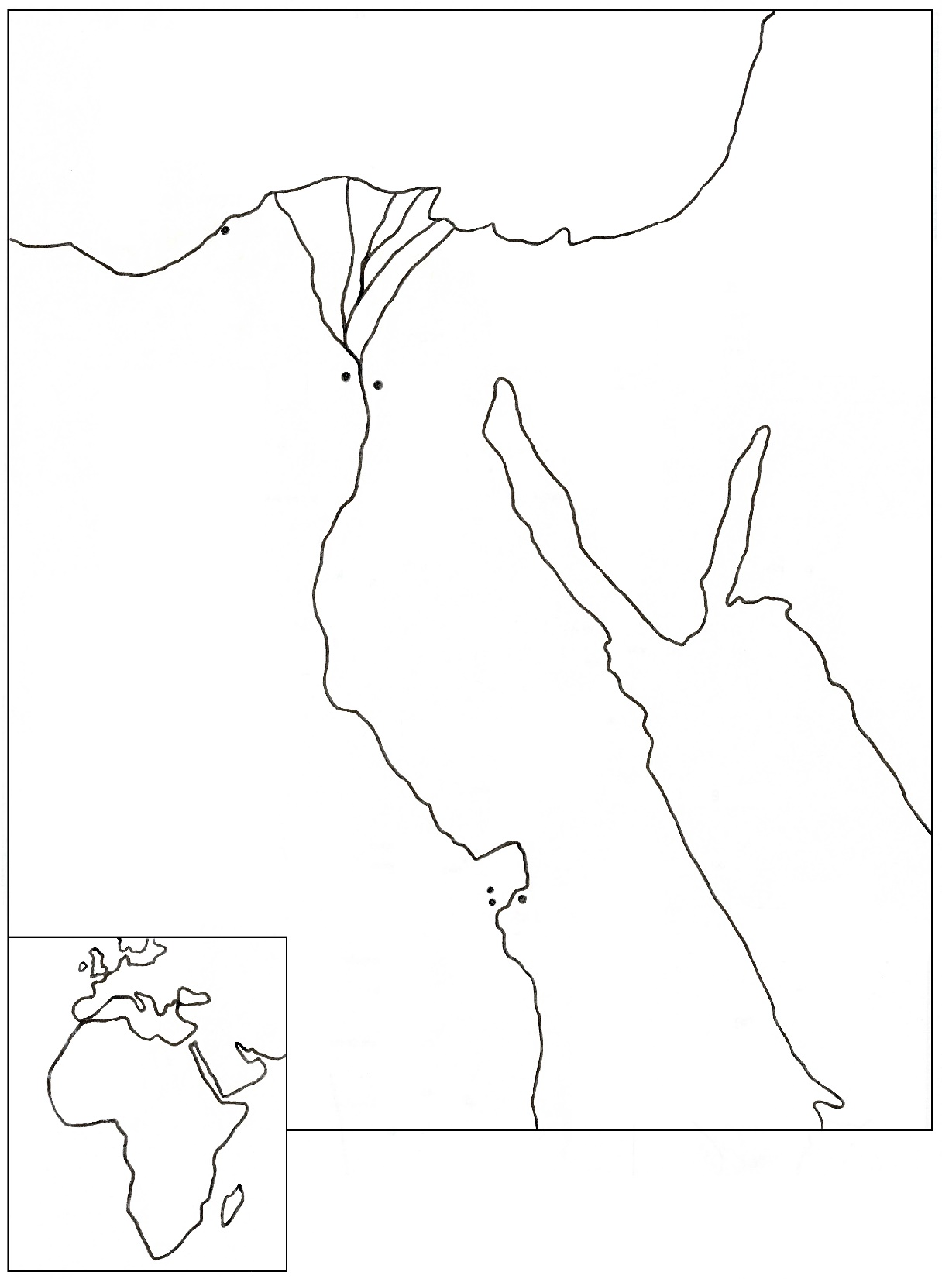
Colour:
the river and seas blue
the flood plains green
The desert yellow
Label:
The Rive Nile
Eastern and Western deserts (either side of Nile)
Giza with the pyramids
Memphis: ancient capital city (used to be located on opposite bank of the Nile from Giza)
Alexandria (capital after Alexander’s rule)
Thebes: capital from Middle Kingdom and where Luxor is now
Valley of the Kings
Deir el medina

Slide 3
Dates on the timeline
BCE is Before Common Era
Years before the year 0
CE is Common Era
Years after the year 0
BCE
CE
2000
BCE
0
1000
CE
2021
CE

