Slide 1
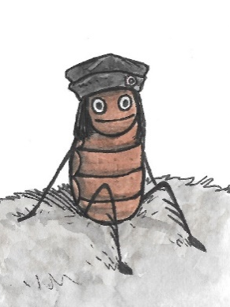
A flea in history
www.readingriddle.co.uk
Why is Florence Nightingale’s work significant?
Lesson 2 of History Lesson plans

Slide 2
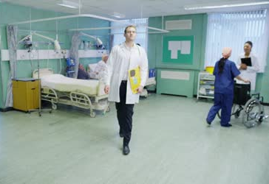
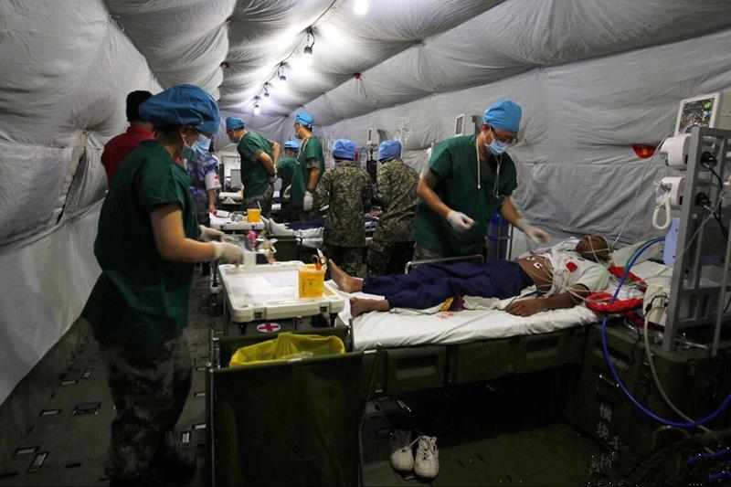
Where have these photos been taken?
A hospital in Britain
A military hospital

Slide 3
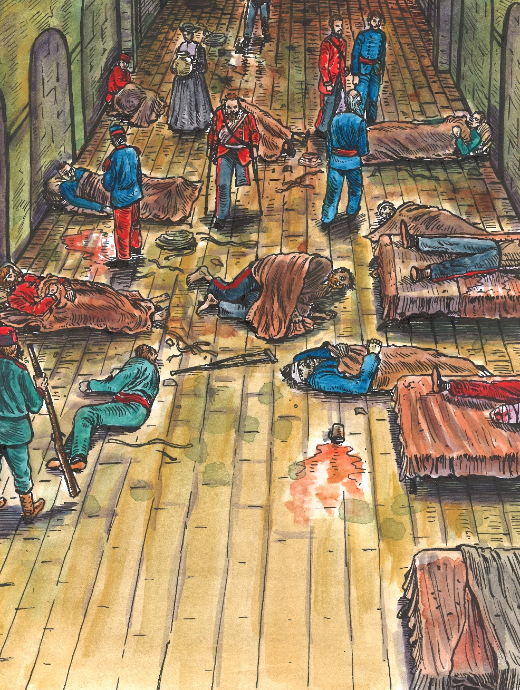
This is Scutari Hospital in 1854 when Florence Nightingale arrived.

Slide 4
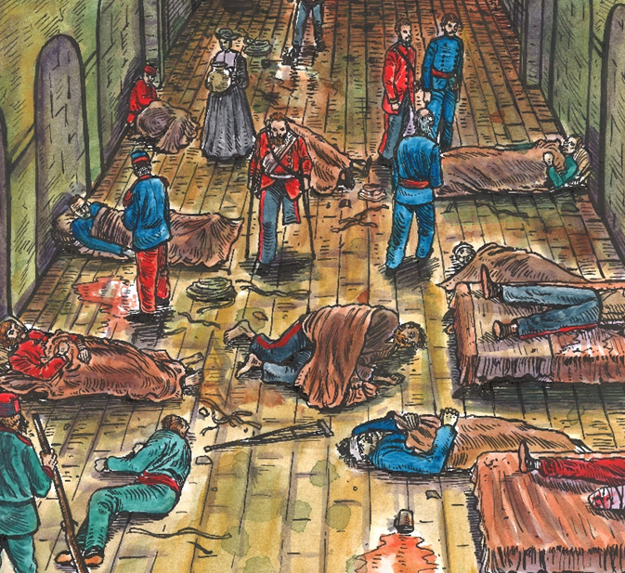

What is the same and what is different about these pictures?
How can you tell that they are both hospitals?
What can you see about the people?
What can you see about the equipment?
Which hospital would you rather be in?

Slide 5
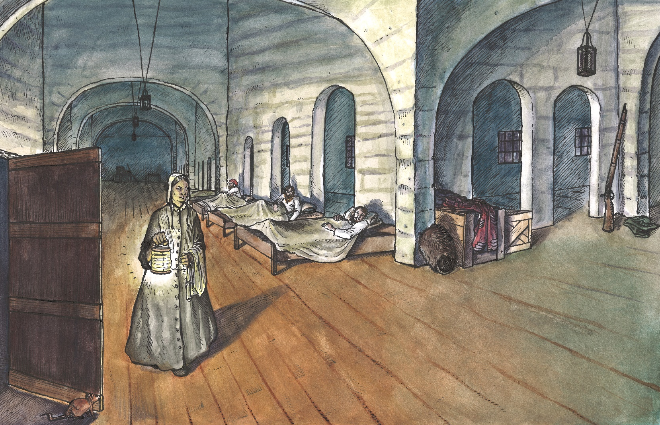
This is Scutari Hospital after Florence Nightingale and her nurses had worked on it. How is it different from when she arrived?

Slide 6
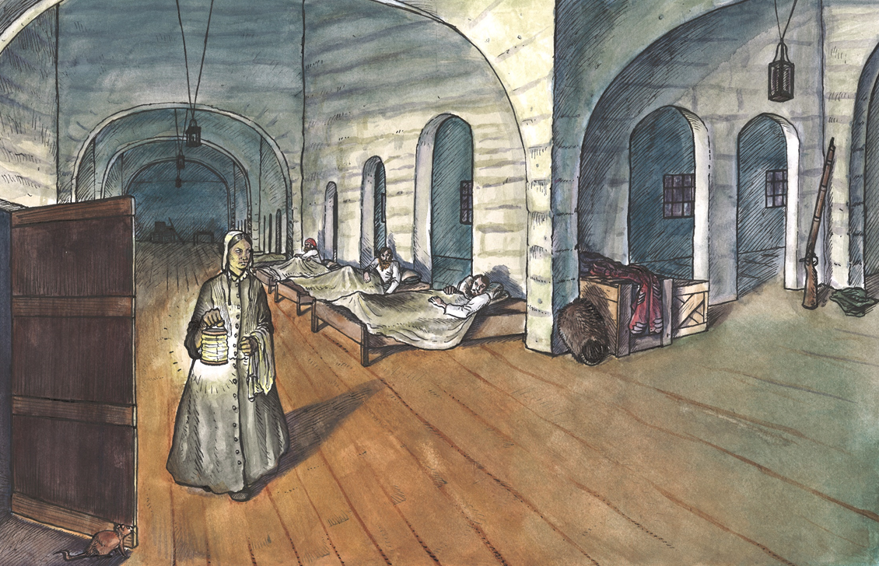
In what way is it still different from a modern hospital?

Slide 7
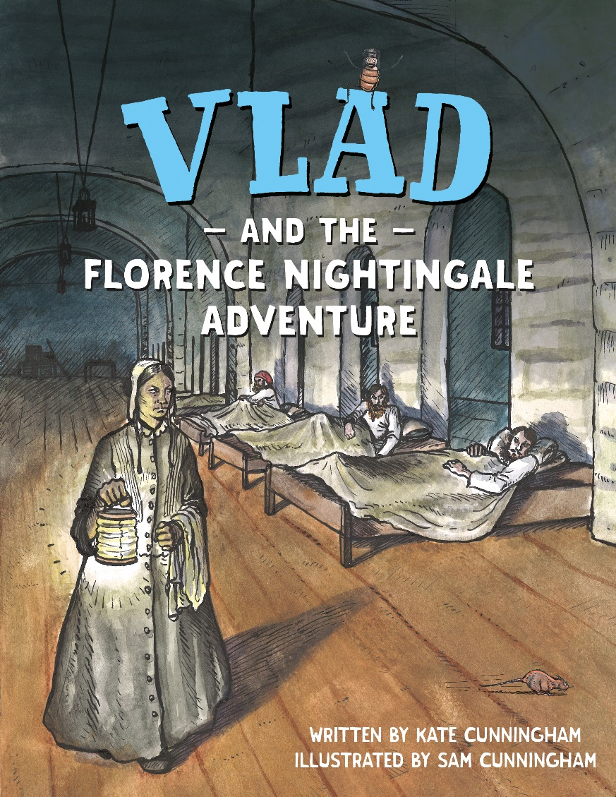
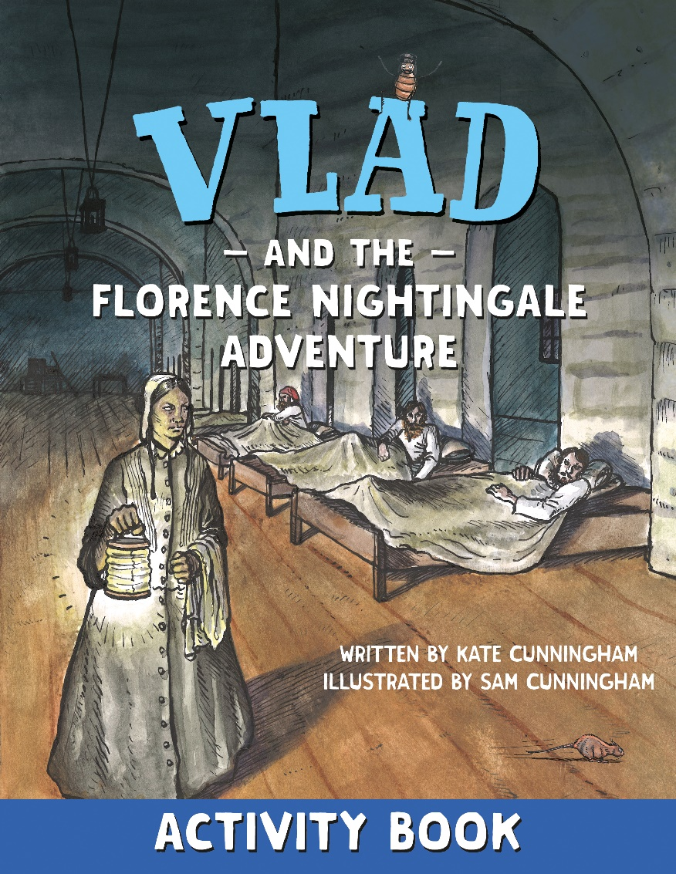
Images from Vlad and the Florence Nightingale Adventure

